Slide 1
The Methods for Translational Mitral/Tricuspid Valve Development
Michael Mack, MD
Baylor Scott & White Health
Dallas, TX

Slide 2
Conflict of Interest Disclosure
Abbott Vascular- Co PI COAPT Trial
Medtronic- Study Chair-APOLLO Trial
Edwards Lifesciences- Co-PI PARTNER 3 Trial

Slide 3
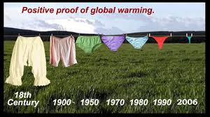
The Treatment of Valvular Heart Disease Is Changing !

Slide 4
SAVR & TAVR Volumes in US
Transcatheter Mitral and Tricuspid Therapy
Is Not TAVR “Redux”!
Source: STS and ACC database as of January 23, 2018

Slide 5
Translational Research in Transcatheter Mitral Valve Therapy

Slide 6
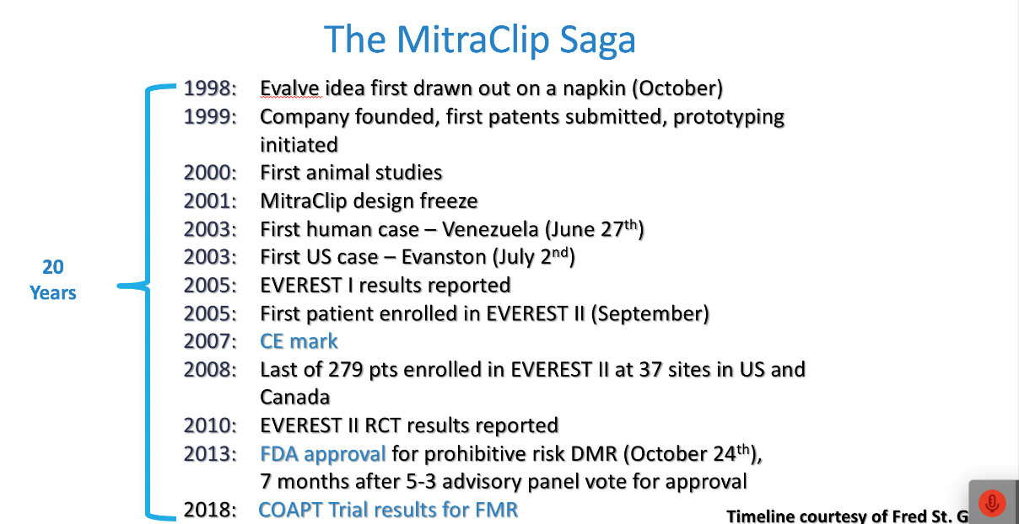
Timeline Courtesy Fred St. Goar

Slide 7
Steps to Successful Medical Device Development
Defining clinical unmet need
Intellectual property considerations
Pre-clinical development
Clinical Evaluation
  EFS
  Pivotal trials
  Clinical Endpoints
Regulatory
Coverage/Reimbursement
Clinical Adoption

Slide 8
Steps to Successful Medical Device Development
Defining clinical unmet need
Intellectual property considerations
Pre-clinical development
Clinical Evaluation
  EFS
  Pivotal trials
  Clinical Endpoints
Regulatory
Coverage/Reimbursement
Clinical Adoption

Slide 9
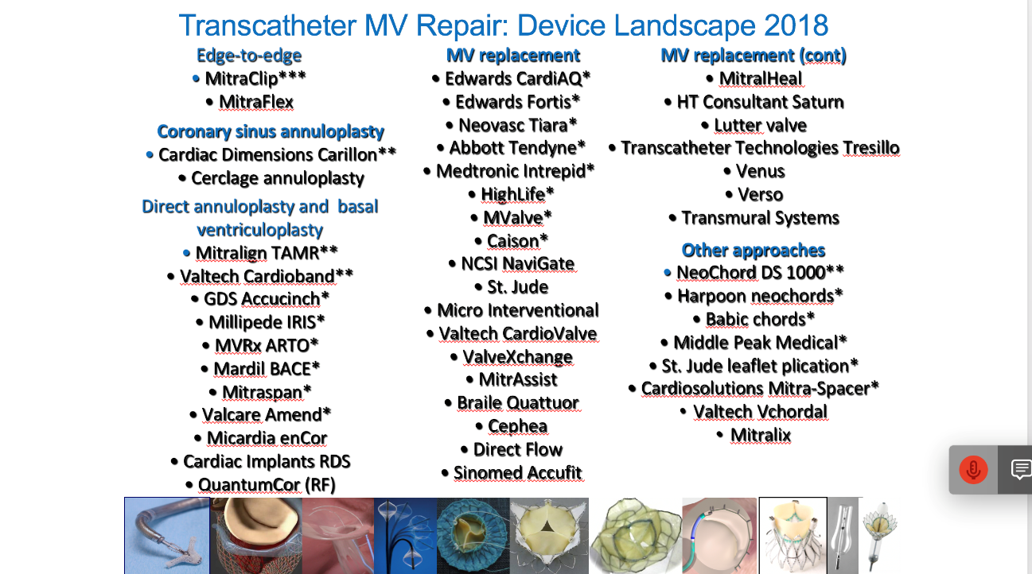
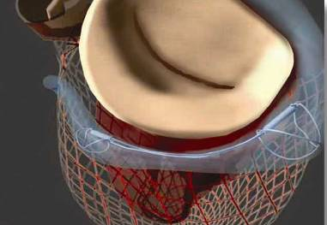
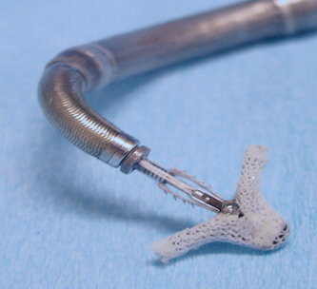
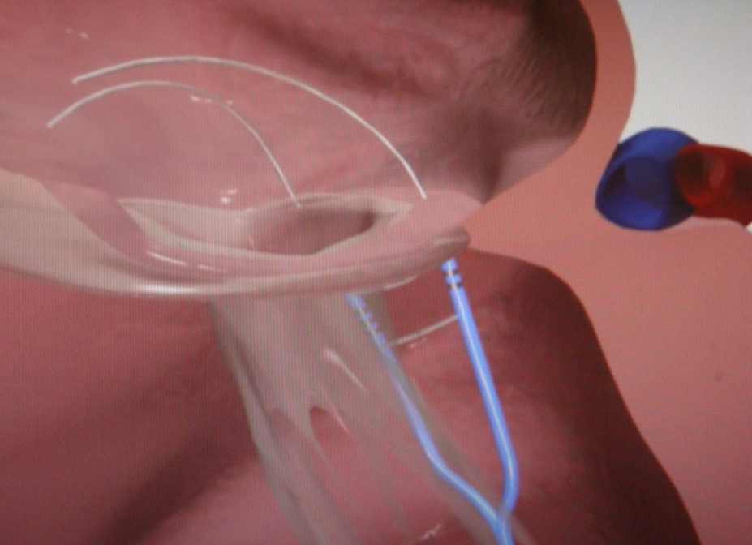
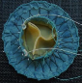

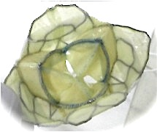
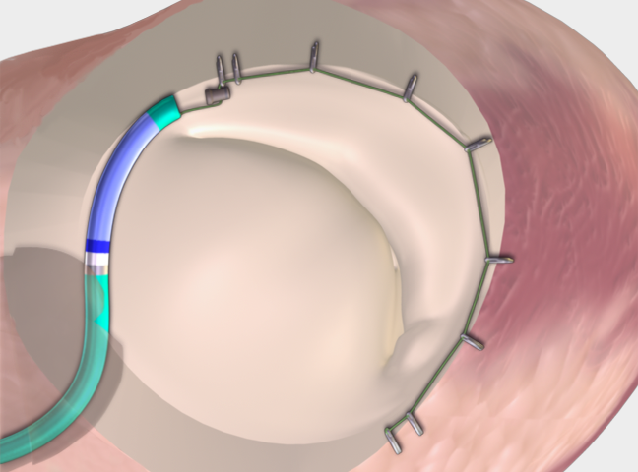
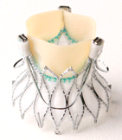
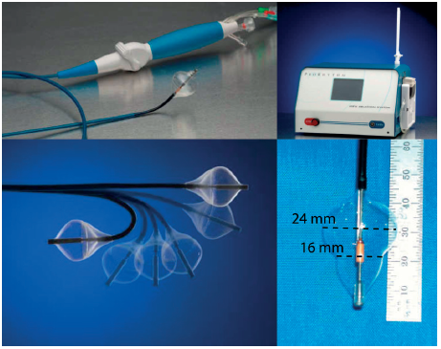

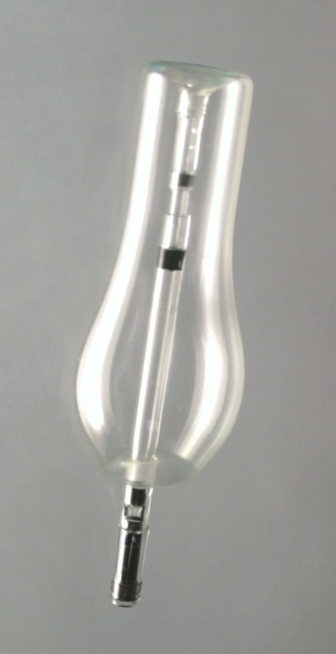
Transcatheter MV Repair: Device Landscape 2018
Edge-to-edge
• MitraClip***
• MitraFlex
Pascal
MV replacement
• Edwards CardiAQ*
• Edwards Fortis*
• Neovasc Tiara*
• Abbott Tendyne*
• Medtronic Intrepid*
• HighLife*
• MValve*
• Caison*
• NCSI NaviGate
• St. Jude
• Micro Interventional
• Valtech CardioValve
• ValveXchange
• MitrAssist
• Braile Quattuor
• Cephea
• Direct Flow
• Sinomed Accufit
MV replacement (cont)
• MitralHeal
• HT Consultant Saturn
• Lutter valve
• Transcatheter Technologies Tresillo
• Venus
• Verso
• Transmural Systems
Other approaches
• NeoChord DS 1000**
• Harpoon neochords*
• Babic chords*
• Middle Peak Medical*
• St. Jude leaflet plication*
• Cardiosolutions Mitra-Spacer*
Valtech Vchordal
Mitralix
Coronary sinus annuloplasty
• Cardiac Dimensions Carillon**
• Cerclage annuloplasty
Direct annuloplasty and basal ventriculoplasty
• Mitralign TAMR**
• Valtech Cardioband**
• GDS Accucinch*
• Millipede IRIS*
• MVRx ARTO*
• Mardil BACE*
• Mitraspan*
• Valcare Amend*
• Micardia enCor
• Cardiac Implants RDS
• QuantumCor (RF)

Slide 10
Mitral Regurgitation U.S.
Disease Prevalence
?
2016 MR Statistics
Total MR Patients
(MR ≥2+)
4,600K
Severe, MR≥3+
2,000K
High-risk, MR≥3+
965K
Large and Growing
Clinical Unmet Need
Annual incidence, MR≥3+
290K
55K
Annual MV surgery (3%)

Slide 11
Tricuspid Valve "The Forgotten Valve"
In 1967, Braunwald advised a conservative approach to TR. It was thought that appropriate correction of the left-sided valve disease would probably result in a decrease or even abolition of functional TR.
Braunwald NS, Ross J Jr, Morrow AG. Conservative management of TR in
patients undergoing mitral valve replacement. Circulation 1967;35(suppl):63–9

Slide 12
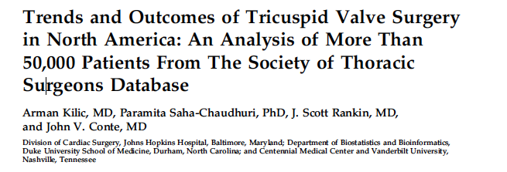
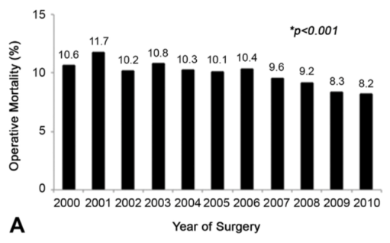
Years-2000-2010
Procedures-54,375
- 4,943/year
Concomitant-46,593 (85.7%)
Isolated- 7,782
707/year
88.9% Repair
30 day mortality-9.6%

Slide 13




Incidence/Management of Tricuspid Regurgitation
50,000
TR cases
1,600,000
Annual New TR
250,000
Annual MR Surgeries
Annual TR Surgeries
5,500
  Argarwal et al.
  Circ Cardiovasc Interv 2009;2:565-573

Slide 14
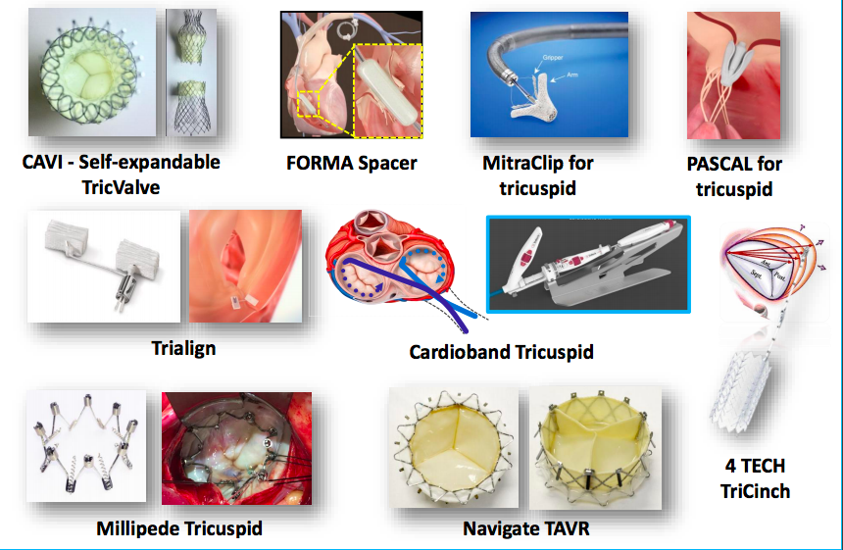

Slide 15
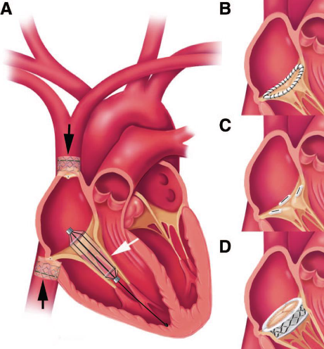
Transcatheter Tricuspid Valve Procedures
Heterotopic implantation of caval valves
Leaflet
  MitraClip
  Pascal
Annuloplasty
  Cardioband
  Trilign
  Fourtech TriCinch
Gap Filler
  Forma
Replacement
Navigate
CAVI
Trisol
Leaflet
Approximation
Filling the coaptation gap
Tricuspid Valve is No Longer Forgotten!
Direct annuloplasty
TV replacement

Slide 16
Steps to Successful Medical Device Development
Defining clinical unmet need
Intellectual property considerations
Pre-clinical development
Clinical Evaluation
  EFS
  Pivotal trials
  Clinical Endpoints
Regulatory
Coverage
Reimbursement
Clinical Adoption

Slide 17
Intellectual Property
Mitral Devices
Edge to Edge
  Oz-1997
Annuloplasty
  Cosgrove-2003
  Ortiz-2002
Replacement
  Teitlebaum-1994
  Bailey-2002
  Hermann-2009
  Rowe-2009
  Lutter-2009
  Quadri-2013

Slide 18
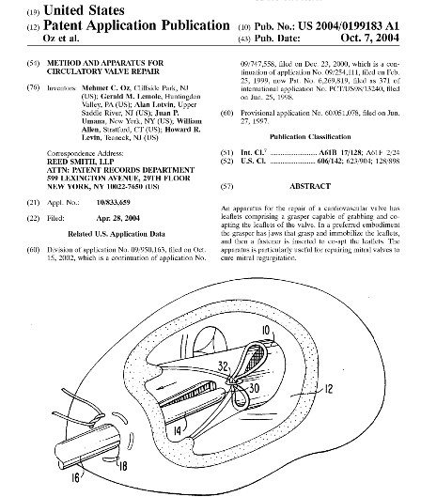
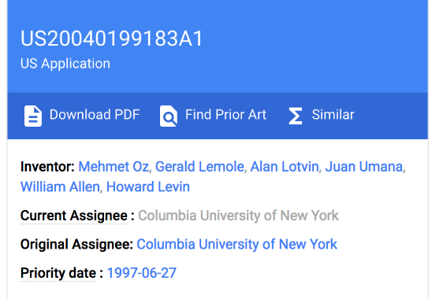
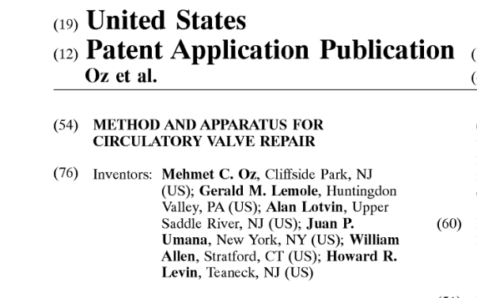

Slide 19
Other Intellectual Property for Mitral Valve
Docks
Delivery Systems

Slide 20
Steps to Successful Medical Device Development
Defining clinical unmet need
Intellectual property considerations
Pre-clinical development
Clinical evaluation
  EFS
  Pivotal trials
  Clinical endpoints
Regulatory
Coverage/Reimbursement
Clinical adoption

Slide 21
Pre-clinical Testing
Mitral/Tricuspid Translational Issues
Quality Management System (QMS)
Design Requirements
  Deliverability
  Structural Integrity
  Functional Performance

Slide 22
System Requirements
Low profile
Atraumatic tracking
Cost-effective
Recapturable/repositionable
Intuitive design-ease of use
Material stability
Guide wire compatibility

Slide 23
Pre-clinical Device Development
Minimum Requirements for Human Testing
System Level Risk Assessment
Structural Component Stress Analysis (FEA)
Structural Component Fatigue Testing
Structural Component Reliability Assessment
Device Corrosion Assessment
Valve Durability
Valve Hydrodynamic Performance
Migration Resistance/Anchoring Integrity
Usability and Deliverability Assessment
Pre-Clinical in vivo Evaluation (Chronic Animal Study)
Crimp Damage Assessments

Slide 24
Steps to Successful Medical Device Development
Defining clinical unmet need
Intellectual property considerations
Pre-clinical development
Clinical evaluation
  EFS
  Pivotal trials
  Clinical endpoints
Regulatory
Coverage
Reimbursement
Clinical Adoption

Slide 25
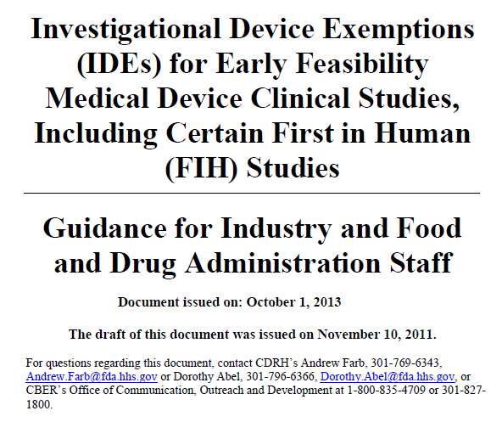
FDA Established Early Feasibility Study (EFS) Guidance in 2013

Slide 26
Why EFS in the US ?
Earlier access to new medical devices for US patients and investigators
Geographic proximity of manufacturers to clinical trial sites facilitates interaction
No language issues
Familiarizes US regulators with the device earlier
Familiarizes clinical sites with device/procedure before pivotal trials

Slide 27
EFS Program: First 4 Years
IDE Approval Trends
CDRH Office of Device Evaluation
Notes:
2-fold increase

Slide 28
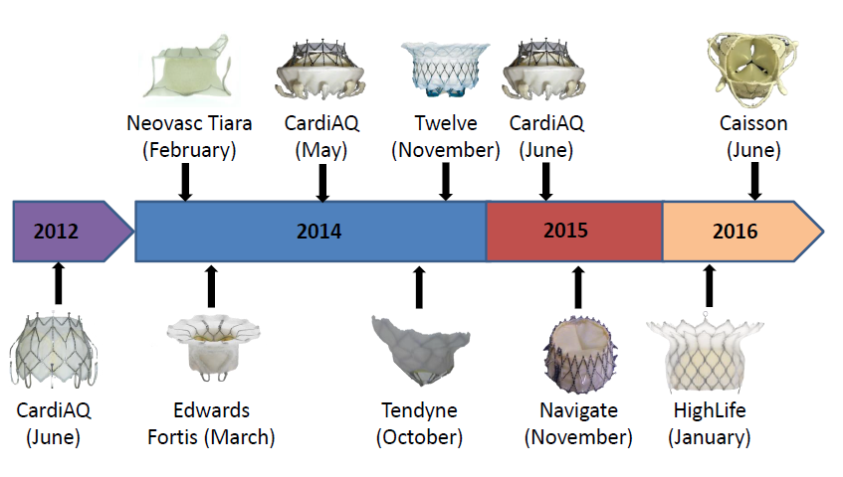
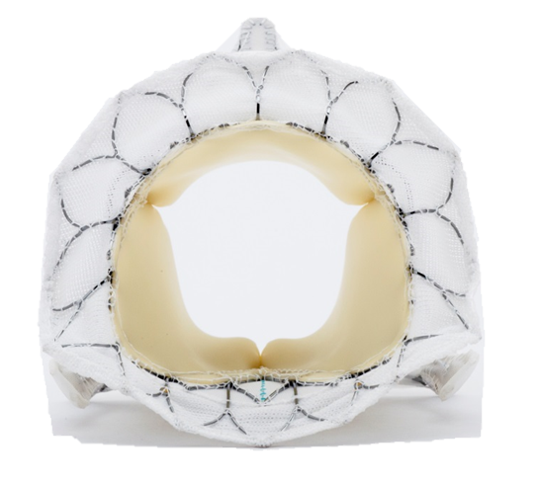
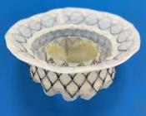
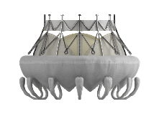
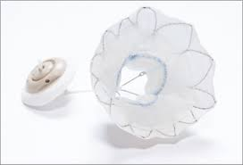
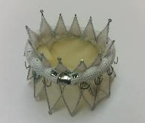
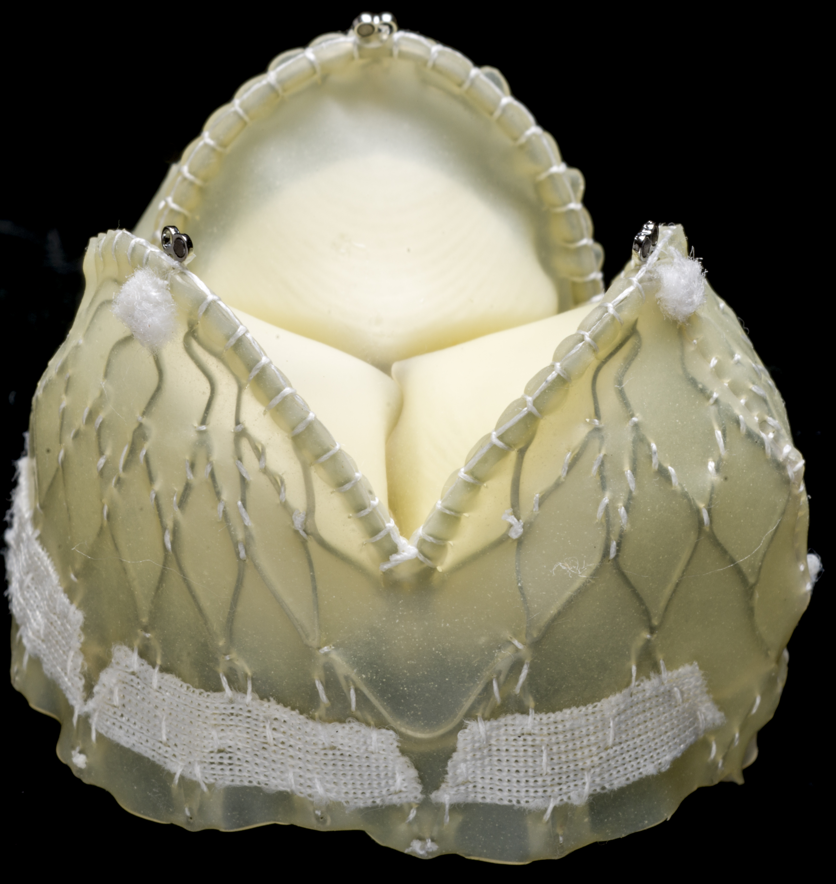
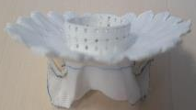
TMVR
EFS in US
Fortis
Intrepid
Tiara
CardiaQ
Navigate
Tendyne
M Dock
Caisson

Slide 29
TMVR Systems
#8
~480 patients treated worldwide
7 Early Feasibility Studies in US
3 Pivotal trials started or will start 2018

Slide 30
Clinical Site Participation in U.S. Early Feasibility Studies
A voluntary, open research network of clinical sites that are committed to high quality, efficient EFS
Clinical site commitment: “60/60/60”
  IRB approval within 60 days
  Contract execution within 60 days
  1st patient enrollment within 60 days after IRB and contract execution

Slide 31
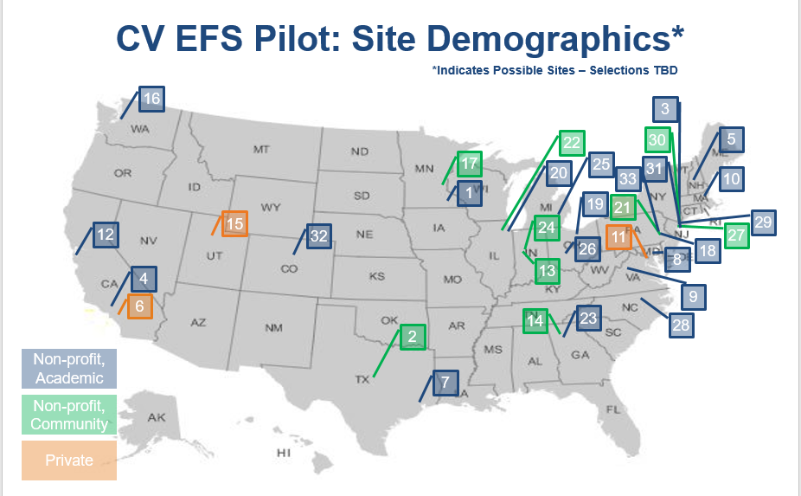

Slide 32
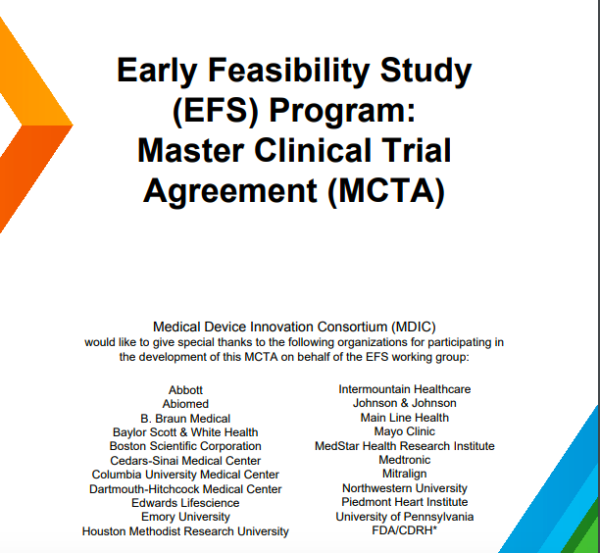

Slide 33
Steps to Successful Medical Device Development
Defining clinical unmet need
Intellectual property considerations
Pre-clinical development
Clinical Evaluation
  EFS
  Pivotal trials
  Clinical Endpoints
Regulatory
Coverage
Reimbursement
Clinical Adoption

Slide 34
Pivotal Trial Design
Ideal Trial
Regulatory
  Prove device is safe and effective
Reimbursement
  Demonstrate device is reasonable and necessary
Clinical Adoption
  Compelling data of benefit (and cost effectiveness)
Change Guidelines
  Randomized

Slide 35
Pivotal Trials in TMVRepair
 | Device | Comparator
EVEREST II | MitraClip in DMR/FMR | MV Repair Surgery
COAPT | MitraClip in FMR | GDMT
CARILLON | CS annuloplasty | GDMT/Sham
ReChord | Neochord artificial chords | SMV Repair
ACTIVE | Edwards Cardioband | GDMT

Slide 36
Ongoing Pivotal Trials in TMVReplacement
 | Device | Comparator
Intrepid | Medtronic TMVR | SMVR
Tendyne | Abbott TMVR | SMVR/r

Slide 37
Steps to Successful Medical Device Development
Defining clinical unmet need
Intellectual property considerations
Pre-clinical development
Clinical Evaluation
  EFS
  Pivotal trials
  Clinical Endpoints
Regulatory
Coverage
Reimbursement
Clinical Adoption

Slide 38
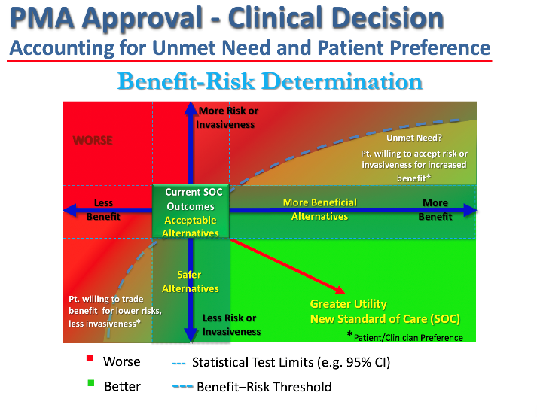

Slide 39
Steps to Successful Medical Device Development
Defining clinical unmet need
Intellectual property considerations
Pre-clinical development
Clinical evaluation
  EFS
  Pivotal trials
  Clinical endpoints
Regulatory
Coverage/Reimbursement
Clinical Adoption

Slide 40
Regulatory/Reimbursement
Regulatory
Reimbursement
Safe
Effective
Reasonable
Necessary

Slide 41
CMS Payment
Coverage
  Will we pay for it?
Reimbursement
  How much will we pay?

Slide 42
CMS Coverage
More use of NCD’s (National Coverage Determinations) vs LCD’s
Increase use of “heart team” approaches (TAVR, MitraClip, LAAO)
Greater requirement for PRO’s (patient reported outcomes)
Favorable view of “evergreen” coverage

Slide 43
Steps to Successful Medical Device Development
Defining clinical unmet need
Intellectual property considerations
Pre-clinical development
Clinical Evaluation
  EFS
  Pivotal trials
  Clinical Endpoints
Regulatory
Coverage
Reimbursement
Clinical Adoption

Slide 44
Clinical Adoption
Creating Value
Improve outcomes
Easier to use
Cost effective

Slide 45
Drivers of Clinical Market Adoption
Evidence of benefit
User (more than patient) friendliness
Teachability

Slide 46
Want Clinical Adoption?
FDA approval is not sufficient
Need compelling evidence
Coverage and reimbursement
Change the guidelines- RCT’s
AUC- comparative effectiveness

Slide 47
Top Mitral/Tricuspid Questions !
Is the unmet need that great?
How will COAPT Trial outcomes affect the field?
Repair or replace?
Crowded space-who will survive?
What will be the IP issues in this crowded field?
Can we facilitate the clinical trial ecosystem?
How do we pay for innovation in the increasingly cost constrained clinical environment?
Will the Mitraclip 20 year saga ever need to be repeated?

Slide 48

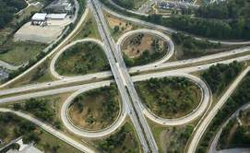
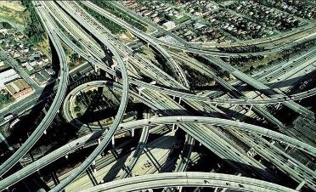
Transcatheter Valve Therapy
TAVR
Mitral
Tricuspid

