Slide 1
The Methods for Coronary Stent Development
Chuck Simonton, MD, FACC
Chief Medical Officer
Divisional Vice President, Global Medical Affairs
Abbott Vascular
Santa Clara, USA
ISCTR Symposium
September 21, 2018
San Diego, CA

Slide 2

Disclosure Statement of Financial Interest
Chief Medical Officer
Divisional Vice President
Global Medical Affairs
Abbott Vascular
Santa Clara, CA, USA
All TCT 2018 faculty disclosures are listed online and on the App.

Slide 3
The Methods for Coronary Stent Development
Drug-Eluting Stent (DES) Design
Preclinical Evidence
Clinical and Regulatory Considerations
Reimbursement Challenges
Unmet Clinical Needs of DES
Future of DES

Slide 4

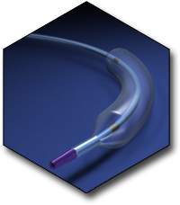
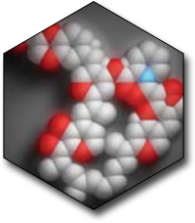
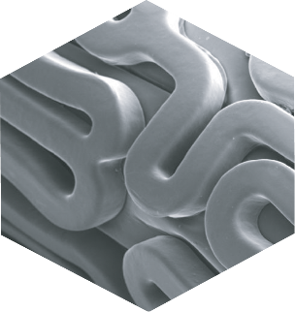
The Four Key Components of DES Design
Scientific Design & Integration
Stent
Platform
Stent Delivery
System
Type
of Drug
Type of Polymer

Slide 5




Stent Patterns – Number of Links and Rings
XIENCE 3.0x18 mm
OrsiroTM 3.0x18 mm
3-Link Peak-to-Valley
13 Rings, 36 Links
3-Link Mid-Strut Link
17 Rings, 48 Links
SynergyTM 3.0x20 mm
OnyxTM 3.0x18 mm
2-Link Offset Peak-to-Peak
17 Rings 35 Links
2-Link Peak-to-Peak
18 Rings 34 Links
INDICATIONS
The XIENCE Sierra stent system is indicated for improving coronary artery luminal diameter in patients, including those with diabetes mellitus, with symptomatic heart disease due to de novo native coronary artery lesions (length  32 mm) with reference vessel diameters of ≥ 2.25 mm to ≤ 4.25 mm. In addition, the XIENCE Sierra stent system is indicated for treating de novo chronic total coronary occlusions.
Pictures taken by and on file at Abbott Vascular

Slide 6
The Drug: Everolimus Mechanism of Action
Growth Factor
receptor
Everolimus
mTOR
cell
signaling
+
-
FKBP12
activated mTOR
nutrients
.
Δ protein synthesis
P27, pppRb, cdk2 activity
G1
S
cell cycle progression

Slide 7
The Polymer: Criteria for All DES Polymers
  Minimal thrombogenicity
  Low to no vascular inflammation
Biocompatibility
  Hardness - crimping
  Elasticity - expansion
  Controlled drug release
  Low drug and polymer load
Drug Control Capability
Mechanical Properties
Polymer Coating
Stability
(different for bioresorbable)
Available, Regulatory
  Lack of chemically reactive groups
  Stable in vivo
  Terminal sterilization
  Commercially available in high purity
  Global regulatory strategy
Processing
  Dissolution
  Coating

Slide 8
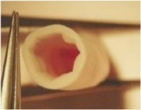
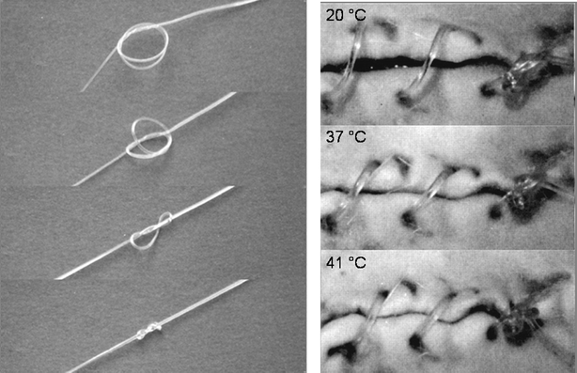
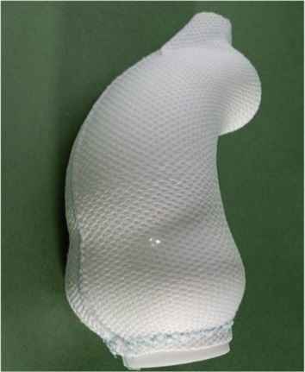
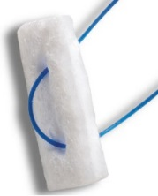
Long History of Fluoropolymers in
Cardiovascular Implants
Use of Fluorinated Polymers:
Demonstrated Benefit:
ePTFE fluoropolymer vascular graft material^{1,2}
Blood and tissue compatible + thrombo-resistant
PVDF-HFP non-absorbable fluoropolymer sutures and meshes for cardiovascular and vascular surgery ^{3,4,5}
Minimal inflammatory response
Low proliferative response
PTFE cardiovascular pledget⁶
In vivo stability
All Desired Characteristics for a Stent Coating
1. Tu et al.; US Patent 4,816,339, 1989. 2. Chandler-Temple, et al. Expanded Poly(tetrafluoroethylene): from conception to biomedical device. Chemistry in Australia 75(8):pp. 3-6. 3. Conze, et al. New Polymer for Intra-Abdominal Meshes-PVDF Copolymer, J Biomed Mat Res Part B: Applied Biomaterials. doi: 10.1002/jbm.b.31106 .4. Klinge, et al. PVDF as a new polymer for the construction of surgical meshes. Biomaterials. 23(2002) 3487-3493. 5. Urban, et al. Why Make Monofilament Suture Out of Polyvinylidene Fluoride? ASAJO Journal 1994. 6. Covidien/Medtronic http://www.medtronic.com/covidien/en-us/products/wound-closure/accessories.html#cardiovascular-pledgets – Last accessed on 9/12/2018.

Slide 9
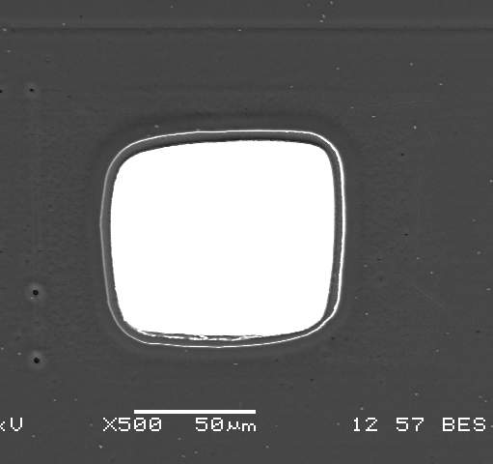
XIENCE – Fluorinated Copolymer
Coating Design Overview
81 μm
Primer
Matrix
PBMA
PVDF-HFP
Primer layer enables excellent coating adhesion and integrity
Fluorinated copolymer minimizes unwanted adhesion to balloon
9

Slide 10
The Methods for Coronary Stent Development
Drug-Eluting Stent (DES) Design
Preclinical Evidence
Clinical and Regulatory Considerations
Reimbursement Challenges
Unmet Clinical Needs of DES
Future of DES

Slide 11
Coronary DES In Vivo Assessment:
Models and Objectives
Animal Models. . . though none are perfect
  Standard models: porcine coronary, rabbit iliac arteries
  Other models: rodents, ovine, canine, non-human primates
Objectives of In Vivo Evaluation
  Proof-of-Concept / Dosing
  Characterization (pharmacokinetics, degradation)
  Safety
  Potential Clinical Efficacy
  Pathogenesis: vessel healing, restenosis, and other risks specific to coronary stents
Notes:
There is no perfect animal model for human coronary artery disease
Multiple species have been used in the preclinical evaluation of stents. The most common animal models used in DES evaluation are porcine coronary arteries and, to a lesser degree, rabbit iliac arteries.
Other species have been used historically in the evaluation of coronary stents, though these have certain disadvantages or are not standardized like the porcine model
There are multiple objective for evaluating coronary stents in vivo as listed here – the focus herein being on assessments for characterization and safety.
The use of animal models to evaluate potential clinical efficacy is a common objective, though again there is no perfect animal model that can wholly reflect what can occur in the clinical setting

Slide 12
Coronary DES In Vivo Characterization:
Pharmacokinetics and Degradation
Pharmacokinetics (PK): drug release, time to complete drug elution; drug levels in artery, myocardium, blood, and peripheral organs
Degradation: intervallic sampling from implant to complete healing (or tissue quiescence)
PK and degradation profiles guide the selection of time points for safety assessment
Notes:
There are three key evaluations conducted in preclinical models – these being pharmacokinetics, degradation (if applicable) and safety.
In vitro work can be of benefit in determining likely time points for follow-up in in vivo pharmacokinetics and degradation studies.
Overall both in vivo PK and degradation studies should include sufficient time points to capture critical phases in drug elution (PK) or bioresorption (degradation) that will then be leveraged towards determining the essential time points at which safety should be assessed.

Slide 13
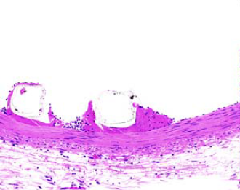
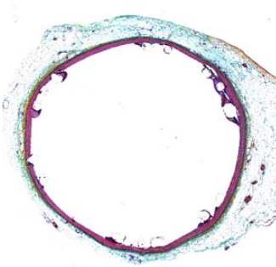
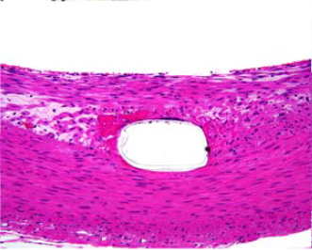
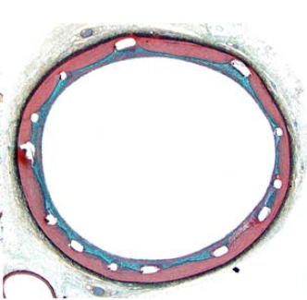
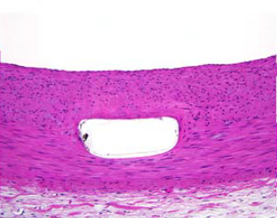
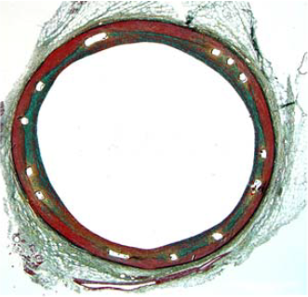
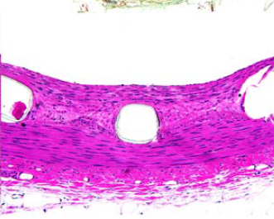
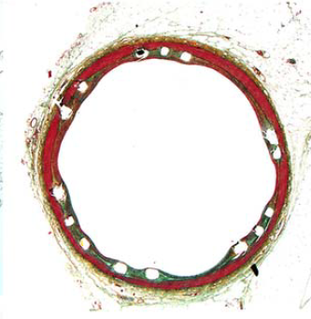
Coronary DES In Vivo Assessment:
Safety Study Design
3 days
Preclinical emulates clinical: implantation techniques and means of assessment match clinical use
Control stent: inclusion in each animal
Evaluation time points:
  Acute: 3, 7 days
  Subchronic: 28 days, ± 90 days
  Chronic: 6 months, 1 year
  Customized Intervallic: dependent on drug release (PK), polymer bioresorption (degradation)
28 days
6 mos
12 mos
Above: Representative photomicrographs of porcine coronary arteries implanted with DES.
Notes:
For any medical device, and coronary stents included, when it comes to the design of a preclinical safety study, the foremost consideration is how to best design the study to emulate the clinical use of the device.
Thus the means for implantation and evaluation preclinically should be as much the same as is intended in patients. Animals should be on similar medication/DAPT regimens as intended for clinical use. Conventionally due to the lack of disease in standard porcine coronary arteries, stents are implanted in straight segments at 10% overstretch to ensure embedment without overstretch injury.
Control devices should be used as a means of comparison in safety studies – rationale should be provided as to why the particular control was selected. Importantly, due to biological variability that is inherent to in vivo studies, each animal should receive at least one control and one test device.
There are several fundamental time points typically required for regulatory approval, though these and additional time points may need to be customized to the particular DES depending on its rate and duration of drug elution and on the bioresorption of polymer, if applicable.
In particular, safety assessment should be done at time points corresponding to the time period of peak drug arterial concentration and/or time period during which the maximum rate of bioresorption occurs

Slide 14
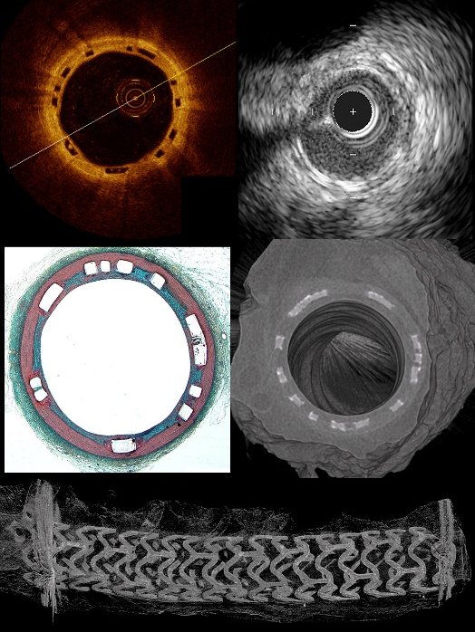
Coronary DES In Vivo Assessment:
Safety Endpoints
Clinical: behavior, serum chemistry, hematology
Imaging: QCA, ± OCT, ± IVUS, ± microCT
Systemic: gross necropsy, evaluation of heart and peripheral organs
Vascular response:
  Histomorphometry: EEL, IEL, lumen, neointimal areas; NI thickness; % stenosis
  Histomorphology: e.g. injury, fibrin, inflammation, SMC loss, mineralization
  Scanning Electron Microscopy: endothelialization
Above: Representative photomicrographs of porcine coronary arteries 28 days after implantation with BRS and evaluated by OCT, IVUS, histology, and microCT.
Notes:
And finally, there are the endpoints that are used to evaluate safety, including
Clinical performance and animal health, including serum chemistry and hematology before and after implantation
In vivo (and ex vivo) imaging
Systemic assessments including the evaluation of the heart and peripheral organs
And the evaluation of the vascular response by histology and scanning electron microscopy

Slide 15
The Methods for Coronary Stent Development
Drug-Eluting Stent (DES) Design
Preclinical Evidence
Clinical and Regulatory Considerations
Reimbursement Challenges
Unmet Clinical Needs of DES
Future of DES

Slide 16
Regulatory Approval Requirements – DES
The global regulatory landscape continues to evolve and result in increased complexity to obtain product approvals
Approvals in Tier 1 countries, such as the US and EU (and others), are often used to support approvals in other regions
While the US FDA is opening up options for manufacturers, the EU is becoming stricter
Cost and agency review timing are also considerations
Notes:
EU/CE Mark – becoming stricter due to EU Medical Device Regulations.
Other countries with increased complexity such as India, and increasing # of countries moving from unregulated to regulated.

Slide 17
US FDA Approval Process
DES regulated through the FDA CDRH, Division of Cardiovascular Devices, Interventional Cardiology Devices branch
Class III device – highest risk, Premarket Approval (PMA)
  Requires comprehensive evaluation of data to demonstrate reasonable assurance of safety and effectiveness
  Guidance documents exist to assist manufacturers on submission requirements
  Pre-submission (Q-sub) for sponsors and FDA to reach consensus on data to support PMA
Notes:
Q-sub process is vital to have an open discussion on sponsor’s proposal and obtain FDA feedback

Slide 18
US FDA Approval Process (continued)
Several clinical trial options
  Early Feasibility Study (EFS) – limited clinical investigation for a new device early in development, approx. 10 patients
    Typical practice was to initiate early study in the EU
    Could lead to refinement of device design before pivotal trial
  First in Human and traditional feasibility studies
  Pivotal Trial – collects definitive evidence of safety and effectiveness (may be a RCT)
    For new devices and changes to devices that affect the safety and effectiveness of the device, e.g. stent material
      New devices – may require demonstration of superiority over current treatment
      Revised devices – demonstration of non-inferiority over other DES
Notes:
The clinical trial option depends on the novelty of the device. New devices representing a new treatment, could benefit from EFS. EFS guidance came out in 2013. Early feasibility studies are appropriate when additional non-clinical testing would not provide the information needed to advance the development process. Because of this, EFS is not appropriate for design iterations.
First in Human study – when a specific indications is evaluated for the first time in human subjects.
Traditional feasibility studies – preliminary safety and effectiveness information on a near-final or final device design. Requires more non-clinical data.
Traditional feasibility studies – preliminary safety and effectiveness information on a near-final or final device design. Requires more non-clinical data.

Slide 19
US FDA Approval Process (continued)
Use of foreign data to support premarket approval
  Challenges to accepting data due to potential patient population or clinical practice differences – but high quality data is increasingly accepted
  Currently recommended over 50% of patients enrolled must be from US sites
Post market information to support approval
  Participation in an established registry as a means to balance pre-approval and post-approval requirements
  Data gathered from a registry may be used as Real World Evidence (RWE) to support future device changes, such as indication expansions
Notes:
FDA is increasingly requesting sponsors to utilize existing patient registries to be able to identify safety and effectiveness issues in a “real world setting”. Generally, sponsors are appreciative of this alternative means to product approval, although participation in a registry is costly and obtaining data to support future is risky.
2015 FDA guidance on guidelines for accepting OUS clinical data – challenges include an OUS patient population that does not represent the US population, differences in endpoints and differences in disease characteristics.

Slide 20
Case Examples
Product | Trial Design | Primary Endpoint | # of Pts
ElunirTM Ridaforolimus ECSS (Medinol) | BIONICS – Pivotal trial, random 1:1 vs. Resolute (MDT), non-inferiority | TLF @ 12 months | 1856
 | BIONICS-PK – Sub-study, first 12 pts through 30 days | N/A | 12
TrytonTM Side Branch (Tryton) | TRYTON – Pivotal trial, random 1:1 (DES+Tryton vs DES+POBA), non-inferiority | TVF @ 9 months | 65 (roll-in) 704 (random)
 | TRYTON Extend Access – Confirmation study, single arm, verify side branch diameters, confirm acute safety, confirm results seen in pivotal | PPMI >3X URL CK-MB @ 48 hours | 133
OrsiroTM Sirolimus ECSS (Biotronik)* | BIOFLOW-V – Pivotal trial, random 2:1 vs XIENCE (ABT) + results from BIOFLOW II&IV OUS Trials, non-inferiority | TLF @ 12 months | 1334
*Not approved in the US
Notes:
Elunir – may have done than 50% US patients that required a sensitivity analysis to be able to pool OUS with US data

Slide 21
EU CE Mark Application Process
Regulated through Medical Devices Directives (MDD)
Notified bodies designated by EU member states assess sponsor’s evidence of conformity to the MDD
Class III – highest risk, Design Dossier approval route
  Requires a comprehensive evaluation of evidence to establish conformity to the MDD and to establish safety and performance
  ISO standards and Meddev guidelines exist to assist sponsors with establishing the evidence
  No pre-submission process to discuss and obtain consensus on filing requirements; however, may file and request written feedback on non-clinical protocols
Notes:
Meddev 2.7/1, revision 4 released in 2016 makes it more difficult for a sponsor to demonstrate clinical equivalence without a clinical trial. The default position is that a sponsor will conduct a clinical trial for new devices, regardless if it is a “me too” device or not. A competitor’s trial data can be used, but an agreement must be reached between the sponsor and the competitor to use the data. This will not happen very often.

Slide 22
US FDA / EU CE Mark Comparison - DES
 | US FDA | EU CE Mark
Class / Filing Type | III / PMA | III / Design Dossier
New device – trial data | Yes – IDE (EFS / pivotal trial), may need to demonstrate superiority; unless “me too” device, demonstrate non-inferiority | Yes – clinical evidence demonstrated through trial data
Modified device – trial data | Yes – if change aspects related to safety and effectiveness, demonstrate non-inferiority | Yes – unless changes do not effect clinical evidence
Agency review cycle | Multiple reviews within FDA coordinated by single reviewer | Multiple reviews within Notified Bodies (NB) and outside NB (medicinal review)
Panel review | For unique, initial device and indication. Formal panel review of clinical data, open to public. Panel review for subsequent “me too” devices may not be necessary. | For both new and modified devices, paper review of all data and NB’s recommendation

Slide 23
Conclusion
Recent guidance from FDA allows options to satisfy demonstration of safety and effectiveness
  EFS, use of foreign data, use of registries to balance pre- vs post-market data
Recent EU Meddev guidance and transition to EU MDR requires more burden on sponsors to demonstrate clinical equivalence
The change in regulatory requirements in the US and EU has a ripple effect on obtaining regulatory approval in other regions thus adding complexity to an already complex regulatory environment

Slide 24
Clinical Data for Expanded DES Indications is Now the Name of the Game in This Mature Device Category

Slide 25
Current State of Coronary DES U.S. Indications
Mature US DES market with second- and third-generation devices with expanded indications
UA/
NSTEMI
Diabetics
Small vessels
Long Lesions
Large Vessel
CTO
XIENCE
SYNERGYTM
ONYXTM

Slide 26
Current State of Coronary DES
Considering the established DES market and increased complexity of PCI, additional indications are being sought
SYNERGYTM
EVOLVE48: very long lesion treatment
EVOLVE DAPT: 3 month DAPT treatment in high bleeding risk patients (HBR)
ONYXTM
Onyx One: 1 month DAPT indication in HBR patients
XIENCE
XIENCE ST DAPT: XIENCE 90 in HBR patients
XIENCE ST DAPT: XIENCE 28 in HBR patients
Onyx One Clear: 1 month DAPT in HBR patients

Slide 27




XIENCE Short DAPT Program
3-month DAPT
1-month DAPT

Slide 28
The Methods for Coronary Stent Development
Drug-Eluting Stent (DES) Design
Preclinical Evidence
Clinical and Regulatory Considerations
Reimbursement Challenges
Unmet Clinical Needs of DES
Future of DES

Slide 29
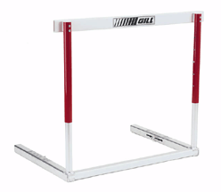
New Hurdles in Device Development
Market Authorization
/Approval
R&D/Regulatory/Clinical
Market Place Challenges
Safety
Effectiveness
Quality
Reimbursement
HTA/Economic Evaluation
Budgeting
Protocols and Restrictions
Patient Cost-Sharing
Value-Based Pricing
Notes:
Successful adoption of new technologies today require overcoming new hurdles beyond safety and efficacy.
Economic considerations have become increasingly important as health systems continue to seek opportunities to contain healthcare costs.
Hospitals and providers have also come under pressure to reduce costs. This has led to increased cost-containment efforts that often impact physician preference in technology utilization and/or availability of new technologies within hospitals.

Slide 30
US Reimbursement for Coronary Interventions is Well Established
New stent technologies will most likely receive coverage and reimbursement under existing mechanisms.
  DRG 246 and 247 for inpatient PCI with DES procedures
  APC 5193 and 5194 for outpatient PCI with DES procedures
Opportunities for additional reimbursement may exist for truly novel technologies. However, these must:
  Have new mechanisms/features, recent FDA approval
  Demonstrate significant clinical benefit compared to standard of care
  Result in significant additional costs to the hospital
Notes:
Reimbursement for PCI procedures in the US is well established. As new, higher cost technologies are introduced, future reimbursement payments will also likely increase as higher hospital charges resulting from the use of these technologies will be incorporated into calculations used to determine future payments.
The most common pathways to obtain incremental reimbursement payment for new technologies under Medicare are:
Inpatient New Technology Add-On Payment (NTAP)
Outpatient Transitional Pass-Through Payment (PTP)
However, these pathways require that the new technology is truly novel, results in significant clinical benefit compared to the standard of care, and the use of which will significantly increase costs to the hospital.

Slide 31
The Methods for Coronary Stent Development
Drug-Eluting Stent (DES) Design
Preclinical Evidence
Clinical and Regulatory Considerations
Reimbursement Challenges
Unmet Clinical Needs of DES
Future of DES

Slide 32
Unmet Clinical Needs of DES in PCI
Requirement of dual anti-platelet therapy (DAPT) and duration of DAPT based on clinical presentation or lesion complexity
In-Stent Restenosis (ISR) occurring at an incremental rate of ~2.5% per year for the life of the patient due to thrombosis, neointimal hyperplasia or neoatheroma, of which 28% presents with STEMI or STEMI¹ and of which 30-40% are simply under-sized or under-expanded stents at the time of the initial implant²
Increased complexity of PCI now putting increased mechanical demands on DES for bifurcations, diffuse disease, heavy calcification and CTOs
Continued reliance on high doses of ionizing radiation and contrast (different than SH and EP which use very little)
Moussa, I et al. The Burden of Restenosis after Coronary Stent Implantation in the United States: Temporal Trends, Clinical Presentation, Treatment Strategies, and In-Hospital Outcomes, TCT 2018
Song, L et al, Eurointervention, 2017 Jun 20;13(3):294-302. doi: 10.4244/EIJ-D-16-00787.

Slide 33
The Methods for Coronary Stent Development
Drug-Eluting Stent (DES) Design
Preclinical Evidence
Clinical and Regulatory Considerations
Reimbursement Challenges
Unmet Clinical Needs of DES
Future of DES

Slide 34
Future of DES in PCI
Clinical data that supports the best duration of DAPT for different patient/lesion subsets
Improved deployment of DES implants to reduce the risk of ISR using intravascular imaging (OCT, IVUS) to ensure proper lesion prep, stent sizing and final expansion
Fully bioresorbable scaffolds that can match DES early outcomes but remove the permanent metallic implant and reduce long-term stent-related events
New imaging technologies that can provide a roadmap for DES implantation reducing the need for ionizing radiation and contrast

Slide 35
IMPORTANT SAFETY INFORMATION
      The XIENCE V®, XIENCE nano®, XIENCE PRIME®, XIENCE PRIME® LL, XIENCE Xpedition®, XIENCE Xpedition® SV and XIENCE Xpedition® LL , XIENCE Alpine®, and XIENCE SierraTM (XIENCE Family) of Everolimus Eluting Coronary Stents on the MULTI-LINK VISION® or MULTI-LINK MINI VISION® Delivery System
      INDICATIONS
      The XIENCE Sierra stent system is indicated for improving coronary artery luminal diameter in patients, including those with diabetes mellitus, with symptomatic heart disease due to de novo native coronary artery lesions (length  32 mm) with reference vessel diameters of ≥ 2.25 mm to ≤ 4.25 mm. In addition, the XIENCE Sierra stent system is indicated for treating de novo chronic total coronary occlusions.
      CONTRAINDICATIONS
      The XIENCE Sierra stent system is contraindicated for use in:
      Patients who cannot tolerate, including allergy or hypersensitivity to, procedural anticoagulation or the post-procedural antiplatelet regimen.
      Patients with hypersensitivity or contraindication to everolimus or structurally related compounds, or known hypersensitivity to stent components (cobalt, chromium, nickel, tungsten, acrylic, fluoropolymers), or with contrast sensitivity.
      WARNINGS
      It is not recommended to treat patients having a lesion that prevent complete inflation of an angioplasty balloon.
      Judicious patient selection is necessary because the use of this device carries the associated risk of stent thrombosis, vascular complications, and/or bleeding events.
      This product should not be used in patients who are not likely to comply with the recommended antiplatelet therapy.
      PRECAUTIONS
      Ensure that the inner package sterile barrier has not been opened or damaged prior to use.
      Stent implantation should only be performed by physicians who have received appropriate training.
      Stent placement should be performed at hospitals where emergency coronary artery bypass graft surgery (CABG) is accessible.
      Subsequent restenosis may require repeat dilatation of the arterial segment containing the stent. Long-term outcomes following repeat dilatation of the stent are presently unknown.
      Care should be taken to control the guiding catheter tip during stent delivery, deployment and balloon withdrawal. Before withdrawing the stent delivery system, visually confirm complete balloon deflation by fluoroscopy to avoid guiding catheter movement into the vessel and subsequent arterial damage.
      When DES are used outside the specified Indications for Use, patient outcomes may differ from the results observed in the SPIRIT family of trials.
      Compared to use within the specified Indications for Use, the use of DES in patients and lesions outside of the labeled indications may have an increased risk of adverse events, including stent thrombosis, stent embolization, MI, or death.
      Orally administered everolimus combined with cyclosporine is associated with increased serum cholesterol and triglycerides levels.
      A patient’s exposure to drug and polymer is proportional to the number and total length of implanted stents. See Instructions for Use for current data on multiple stent implantation.
      Safety and effectiveness of the XIENCE Family of stents have not been established for subject populations with the following clinical settings:
        Patients with prior brachytherapy of the target lesion or the use of brachytherapy for treated site restenosis, patients in whom mechanical atherectomy devices or laser angioplasty catheters are used in conjunction with XIENCE Family stents, women who are pregnant or lactating, men intending to father children, pediatric patients, unresolved vessel thrombus at the lesion site, coronary artery reference vessel diameters < 2.25 mm or > 4.25 mm or lesion length > 32 mm, lesions located in saphenous vein grafts, unprotected left main coronary artery, ostial lesions, lesions located at a bifurcation or previously stented lesions, diffuse disease or poor flow (TIMI < 1) distal to the identified lesions, excessive tortuosity proximal to or within the lesion, recent Acute Myocardial Infarction (AMI) or evidence of thrombus in target vessel, multivessel disease, and in-stent restenosis.
Everolimus has been shown to reduce the clearance of some prescription medications when administered orally along with cyclosporine (CsA). Formal drug interaction studies have not been performed with the XIENCE Family of stents because of limited systemic exposure to everolimus eluted from the stent.
Everolimus is an immunosuppressive agent. Consideration should be given to patients taking other immunosuppressive agents or who are at risk for immune suppression.
Oral everolimus use in renal transplant patients and advanced renal cell carcinoma patients was associated with increased serum cholesterol and triglycerides, which in some cases required treatment.
Non-clinical testing has demonstrated that the XIENCE Sierra stent, in single and in overlapped configurations up to 71 mm in length, is MR Conditional. It can be scanned safely under the conditions in the Instructions for Use.
The XIENCE Family of stents should be handled, placed, implanted, and removed according to the Instructions for Use.
Caution: This product is intended for use by or under the direction of a physician. Prior to use, reference the Instructions for Use provided inside the product carton (when available), at eifu.abbottvascular.com or at Manuals.sjm.com for more detailed information on Indications, Contraindications, Warnings, Precautions and Adverse Events.

Slide 36
IMPORTANT SAFETY INFORMATION (CONTINUED)
      The XIENCE V®, XIENCE nano®, XIENCE PRIME®, XIENCE PRIME® LL, XIENCE Xpedition®, XIENCE Xpedition® SV an-d XIENCE Xpedition® LL , XIENCE Alpine®, and XIENCE SierraTM (XIENCE Family) of Everolimus Eluting Coronary Stents on the MULTI-LINK VISION® or MULTI-LINK MINI VISION® Delivery System
      POTENTIAL ADVERSE EVENTS
      Adverse events (in alphabetical order) which may be associated with percutaneous coronary intervention treatment procedures and the use of a coronary stent in native coronary arteries include, but are not limited to, the following:
      Abrupt closure, hematoma, or hemorrhage, Acute myocardial infarction, Allergic reaction or hypersensitivity to latex, contrast agent, anesthesia, device materials (platinum, polymer, cobalt, chromium, nickel, tungsten, acrylic, fluoropolymers), and drug reactions to everolimus, anticoagulation, or antiplatelet drugs, Arterial rupture, Arteriovenous fistula, Arrhythmias, atrial and ventricular, Bleeding complications, which may require transfusion, Cardiac tamponade, Coronary artery spasm, Coronary or stent embolism, Coronary or stent thrombosis, Death, Dissection of the coronary artery, Fever, Hypotension and/or hypertension, Ischemia (myocardial), Myocardial infarction (MI), Nausea and vomiting, Palpitations, Peripheral ischemia, Pseudoaneurysm, Renal Failure, Restenosis, Shock/pulmonary edema, Stroke/cerebrovascular accident (CVA), Total occlusion of coronary artery, Unstable or stable angina pectoris, Vascular access complications which may require vessel repair, Vessel dissection
      The risks described below include, but are not limited to, the anticipated adverse events relevant for the cardiac population referenced in the contraindications, warnings, and precautions sections of the everolimus labels.
      Abdominal pain; Anemia; Angioedema; Constipation; Cough; Diarrhea; Dyslipidemia (including hyperlipidemia and hypercholesterolemia); Dyspnea; Edema (peripheral); Headache; Hyperglycemia; Hypertension; Hypokalemia; Elevations of serum creatinine; Infections: bacterial, viral, fungal, and protozoan infections (may include opportunistic infections); Lymphoma and skin cancer; Male infertility; Oral ulcerations; Nausea; Non-infectious pneumonitis; Pain; Proteinuria; Pyrexia; Rash; Thrombotic microangiopathy (TMA)/Thrombotic thrombocytopenic purpura (TTP)/Hemolytic uremic syndrome (HUS); Urinary tract infection; Upper respiratory tract infection; Vomiting
      Live vaccines should be avoided and close contact with those that have had live vaccines should be avoided. Fetal harm can occur when administered to a pregnant woman. There may be other potential adverse events that are unforeseen at this time.
Caution: This product is intended for use by or under the direction of a physician. Prior to use, reference the Instructions for Use provided inside the product carton (when available), at eifu.abbottvascular.com or at Manuals.sjm.com for more detailed information on Indications, Contraindications, Warnings, Precautions and Adverse Events.

Slide 37
Caution: This product is intended for use by or under the direction of a physician. Prior to use, reference the Instructions for Use provided inside the product carton (when available), at eifu.abbottvascular.com or at Manuals.sjm.com for more detailed information on Indications, Contraindications, Warnings, Precautions and Adverse Events
Tests performed by and data on file at Abbott.
Illustrations are artist’s representations only and should not be considered as engineering drawings or photographs.
Photos on file at Abbott.
Abbott
3200 Lakeside Dr., Santa Clara, CA. 95054 USA, Tel: 1.800.227.9902
Resolute Onyx is a trademark of Medtronic.
Synergy is a trademark of Boston Scientific.
Orsiro is a trademark of Biotronik.
Elunir is a trademark of Cordis Corporation.
Tryton is a trademark of Tryton Medical, Inc.
www.Vascular.Abbott
©2018 Abbott. All rights reserved. SE2946837 Rev A
37 of 40

