Slide 1
Clinical/Surrogate Endpoints and Innovative Approaches for Catheter Ablation Studies
FDA Perspective
Marco Cannella, PhD
Senior Lead Reviewer
Cardiac Electrophysiology Devices Branch
FDA – CDRH – Office of Device Evaluation
ISCTR Consensus Summit
San Diego, California
September 21, 2018
Notes:
The CEDB branch reviews ablation, mapping and imaging devices typically used during an EP study.
I am going to present our prospective about clinical endpoints for catheter ablation studies.

Slide 2
No Disclosures
Notes:
No disclosure

Slide 3
FDA’s Role
Protects the public health
Advances the public health by helping to speed innovations, and by helping the public get accurate, science-based information to use medical products
Works with other groups supporting patients
Clinical Research
Payors (CMS/Ins.)
Industry
Clinicians
Regulatory (FDA)
ODE evaluates medical devices for:
clinical trials
marketing
Patients
Notes:
The FDA’s mission is supportive of speeding innovation and providing accurate and science-based information to the public.
FDA works in collaboration with other groups and institution to support patients.
The office of device evaluation makes a device risk/benefit assessment for Feasibility (developmental) studies and marketing (pivotal) studies.

Slide 4
Endpoints or Answers?
Endpoints are important for marketing studies Answers are needed to improve understanding!
Experience
Uncertainty
t
Early Feasibility
Traditional Feasibility
Pivotal
Confirmatory
Device developments
Endpoints development
Test new approaches
Mechanism of action
New technology
Novel design
New indication
Small change
New feature
Answers
Endpoints
Notes:
Advances in treating patients with arrhythmia (AFL, AF, etc ) may be achieved with new devices or better understanding on how to use approved devices.
ENDPOINTS are important to support approval of new devices.
ANSWERS are needed from feasibility (and investigator) study to investigate how to get best results with approved/proposed devices (for example how to best use force sensing information) and to provide preliminary information for choosing an appropriate pivotal study design (endpoints).

Slide 5
Designing Study Endpoints
Endpoints characterize the clinical effect of the device (for both safety and effectiveness) for the desired intended use.
Important factors to consider when developing endpoints:
Indication for use:
Population (drug refractory, etc…)
Arrhythmia (AFL, AF, VT, etc… )
Device design (focal, balloon, etc…)
Device operational principle (RF, Cryo, etc…)
Scientific considerations:
Prior clinical experience (feasibility studies)
Current consensus *
*2017 HRS/EHRA/ECAS/APHRS/SOLAECE expert consensus statement on catheter and surgical ablation of atrial fibrillation (Calkins H. et al., Heart Rhythm, Vol 14, No 10, Oct 2017)
Notes:
Several factors need to be considered when developing endpoints for a marketing study to support a specific indication for use.
Important key factor to consider are:
The indications for use to be sought (e.g. typical atrial flutter, symptomatic drug refractory paroxysmal Atrial fibrillation, drug/device refractory ischemic Ventricular Tachycardia)
The mechanism of action of a technology (i.e. RF, Cryo, Laser, other ablating source)
Scientific evidence collected in feasibility study (for new technology) or
Current consensus document (for technology already developed).
The HRS consensus statements on catheter ablation is a useful guideline for developing reasonable and meaningful endpoints for a clinical study in this arena.

Slide 6
Endpoints for Ablation Studies
SAFETY Endpoint:
For ablation devices it is typically a 30-day complication rate.
Composite safety endpoint is developed to capture device procedure related complications.
EFFECTIVENESS Endpoint:
For Atrial Flutter (AFL) an accepted surrogate is achievement of bidirectional block (acute effectiveness)*
For Atrial Fibrillation (AF) indication it is typically 12-month follow-up
For Ventricular Tachycardia (VT) indication it is typically evaluated within 6 to 12 months post procedure
*specifically for conventional RF ablation catheters. FDA is open to expand the use of this surrogate to other technology (Cryo, Laser, etc…) with valid scientific evidence (clinical trial, RWE, registry, etc …).
Notes:
For many ablation device studies a 30-day complication rate is typically accepted as safety endpoint.
A COMPOSITE safety endpoint is recommended to capture the device and procedure related complications.
Effectiveness at 12 months follow-up is typically accepted for devices with an Atrial Fibrillation indication.
For Atrial Flutter indication, bidirectional block (acute effectiveness) is an accepted surrogate for conventional Radio Frequency (RF) ablation catheter.
FDA is open to expand the use of surrogate to other technology with valid scientific evidence … this scientific evidence can be provided by RWE, registry data or as an answer to a feasibility study that has been design to validate the use of a specific surrogate.

Slide 7
Endpoints (answers) for Feasibility Studies
The “answers” provided by feasibility and investigator studies can be used to shape the pivotal study endpoints or understand the best use of approved devices
EFS Studies (example: MR guided ablation)
Is the device design optimized for clinical use?
Are there potential advantages over conventional therapies?
Feasibility Studies (examples: force sensing derived indexes, novel mapping diagnostic features)
What is the clinical utility of these indexes?
How can the mapping algorithm be validated?
What parameter may improve the therapeutic outcome?
Notes:
This leads to the importance of feasibility and investigator studies to provide answers to improve the quality of treating patients and the robustness of endpoints selection for pivotal studies.
Feasibility Studies may help to determine if a novel device design (for example an MR guided catheter) has been optimized for clinical use and provides meaningful information to adequately design a future clinical data collection.
Investigator Studies may help to determine the clinical utility of the proposed new feature or best use of approved devices and gather preliminary evidence to appropriately design a pivotal study (which endpoint would capture the proposed therapeutic outcome or the sought improvement in indication)

Slide 8
FDA Support of Clinical Study
Encourage innovation to answer clinical questions with EFS, Feasibility, and Investigator studies
Interactive reviews to facilitate the efficient and timely review and evaluation of IDE submissions
Least burdensome approach for new clinical studies:
novel study designs (Bayesian stats, modeling)
support use of Real World Evidence (RWE)
use of registries to support device small changes
Let’s step back and find the answer to the questions (arrhythmias mechanism, validity of proposed surrogate, etc…) that will help us shape the endpoints for the future.
Notes:
Here are some of the things the FDA is doing to speed innovation:
- Encourage early feasibility study to start gaining experience on new technologies
- Facilitate communication during the review process to meet the industry timeline (IDE are free and always reviewed in 30-day)
- Implementing a least burdensome approach by learning from already available sources (Bayesian approach, RWE, registries …)
[Even if feasibility studies may not provide the adequate evidence needed for a marketing application, they may substantially facilitate the development of an acceptable pivotal study design.]
The evidence gathered about the best use of approved devices and new features may improve the safe and effective use of medical devices and support expanded indications.
Overall the evidence gathered through feasibility studies may lead towards the development of new endpoints and advancing the scientific knowledge.
As our understanding of the underlying mechanisms of arrhythmias and their ablation therapies continues to improve, endpoints currently being used in catheter ablation studies are likely to evolve and novel endpoints may be developed to facilitate the evaluation of new catheter ablation devices and procedures.

Slide 9
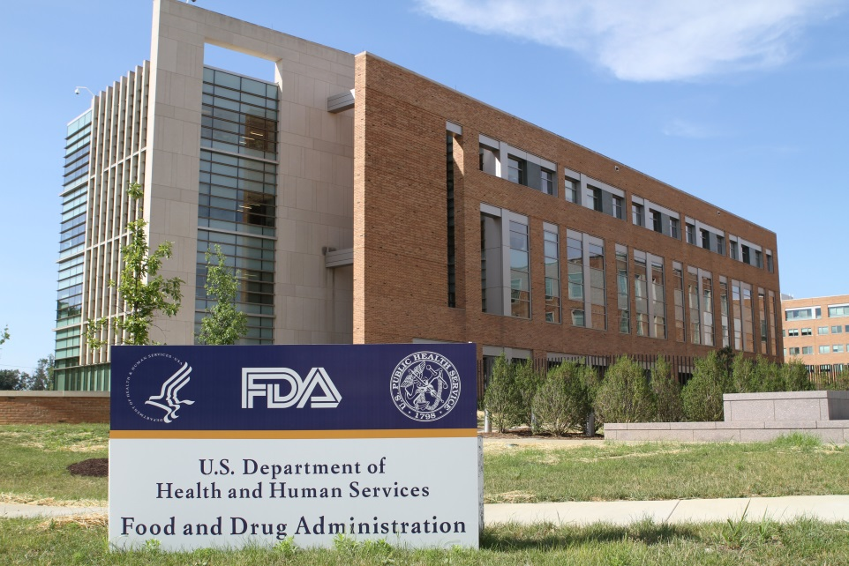
THANK YOU
DCD Director: Bram Zuckerman
bram.zuckerman@fda.hhs.gov
CEDB - Ablation, Mapping, Imaging
Mark Fellman
301-796-6357
mark.fellman@fda.hhs.gov
IEDB - Pacing, ICDs, CRT, Leads
Jessica Paulsen
301-796-6883
jessica.paulsen@fda.hhs.gov
CDDB - Monitors, ECGs, Diagnostics, AEDs
Marco Cannella
301-796-1657
marco.cannella@fda.hhs.gov
Notes:
Here is contact information for the electrophysiology (EP) side of the Division of Cardiovascular Devices

