Slide 1
The TAVR Development
from Concept to First in Man
Alain Cribier
University of Rouen, France

Slide 2
Disclosure Statement of Financial Interest
Within the past 12 months, I or my spouse/partner have had a financial interest/arrangement or affiliation with the organization(s) listed below.
Affiliation/Financial Relationship
Company
Consulting Fees/Honoraria
Edwards Lifesciences

Slide 3
From 1985: Our Goal in Developing Transcatheter Valve Interventions for the Treatment of Degenerative AS
« Finding solutions to an important unmet clinical need »
FIM:
The Lancet
Jan 1986
FIM:
Circulation
Dec 2002
Sept 1985
Balloon Aortic
Valvuloplasty (BAV)
April 2002
Transcatheter Aortic
Valve Replacement (TAVR)
Don’t untertake a project unless it is manifestly important and nearly impossible
Edwin Land

Slide 4
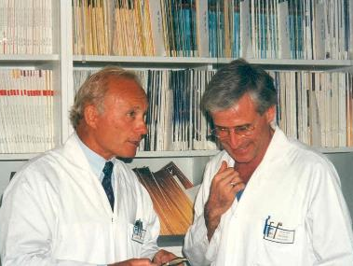
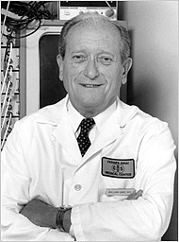
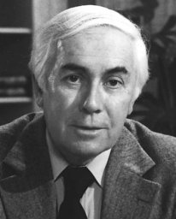
What made possible the development of these
innovative technologies in Rouen ?
1- The crucial influence of outstanding mentors
William Ganz
Jeremy Swan
Brice Letac
Cedars Sinaï Medical Center, LA
Director Dpt of Cardiology, Rouen

Slide 5
What made possible the development of these
innovative technologies in Rouen ?
2- A “Dream Team”
of nurses, technicians, TAVI coordinator, cardiologists and surgeons
2010
Pr J.P. Bessou
Head of
Cardiac Surgery
Pr H. Eltchaninoff
Head of
Cardiology
An incredible high and rare relationship,
support and interaction between cardiac surgeons
and interventional cardiologists

Slide 6
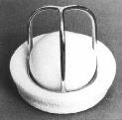
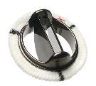
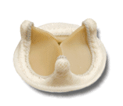
Therapeutic Options for Symptomatic AS
Surgical AVR
SAVR declined in 1/3 of cases
BUT
No AVR
AVR
The standard of care for decades
Euro Heart
Survey 1994
Low mortality in good surgical candidates
Return to normal life expectancy
Bouma
1999
Iung
2004
Pellika
2005
Charlson
2006
Bach
2006
Mortality > 80% at 2 years
In the 1980s in Rouen, SAVR was regularly
declined in patients older than 70 y !

Slide 7
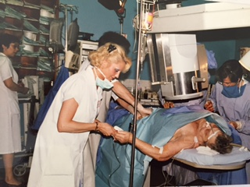
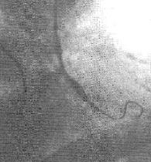
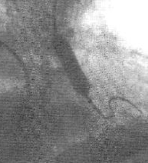
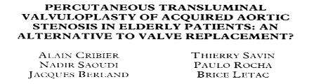
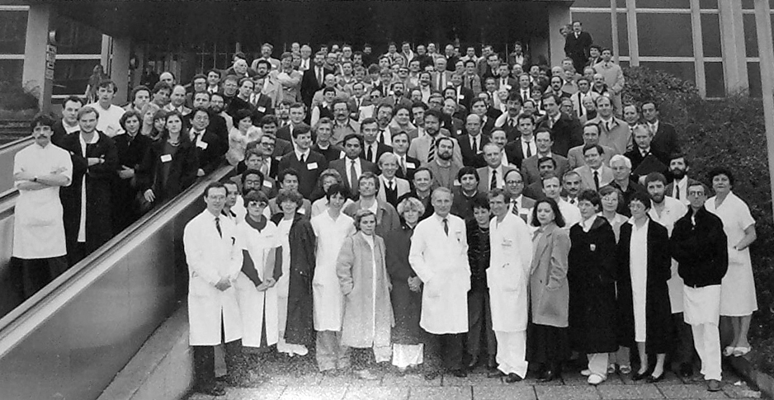
Rouen, Sept 1985
F.I.M. - Balloon Aortic Valvuloplasty
72 year-old woman
Highly symptomatic:
- Several daily syncopal attacks
- NYHA IV
- CAD (angina / past-AMI)
Declined for surgery (age + CAD)
No symptom during 2 years, return to normal life
Enthusiastic response of the medical community !
Notes:
7

Slide 8
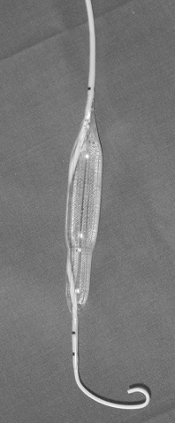
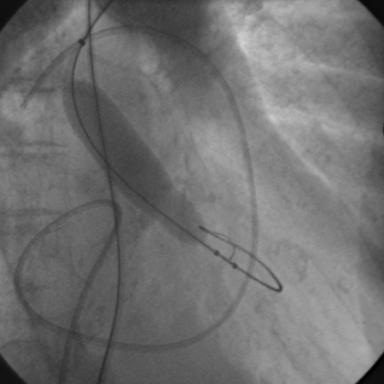
From 1985- Balloon Aortic Valvuloplasty
Mechanisms of action:
Cribier-Letac
Double Size Balloon
(Mansfield)
23 mm
Fracture of calcific nodules
23 mm
A specifically designed balloon catheter
Separation of fused commissures, if any
Huge International registries
(Mansfield, NHLBI)
> 1000 index articles
Symptomatic improvement
Less rehospitalization
No effect on long term survival
Early valvular restenosis
BAV progressively abandoned
Solving the problem of early restenosis
became for us an obsession

Slide 9
BAV is not dead ! Resurgence with onset of TAVR
ACC/AHA guidance (2014) : Bridge to TAVR or SAVR in severely symptomatic AS
ESC/ EACTS guidance (2012): urgent non cardiac surgery and palliation of symptoms
Rapid ventricular pacing
Initiated by us in BAV to stabilize the balloon
Extended then to balloon expandable TAVR
Balloon
inflation/deflation
An improved / simplified procedure
Balloon size: 20, 23, 25mm
Small size sheaths (10F)
Local anesthesia / preclosing
3 days of hospitalization
BAV remains integrated to many TAVR
procedures (pre / post-dilatation, balloon sizing)

Slide 10
Transcatheter Aortic Valve Replacement
An unrealistic project aimed at improving
the results of BAV while eliminating restenosis
“ Implanting a valve prosthesis within the diseased calcific aortic valve, without removing the native valve, on the beating heart, using regular percutaneous catheter based techniques and local anesthesia”
A. Cribier, 1994

Slide 11
Background on catheter-based systems to treat valvular diseases (mainly AR)
1965 Davies: catheter-mounted inverted plastic cone
1971 Moulopoulos: spherical and umbrella-shaped balloons
1976 Philips: balloon valve
1992 Matsubara: balloon valve
Davis Valve 1965
Molopoulos valve 1971

Slide 12
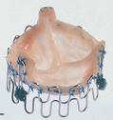
Transcatheter Valve: recent pioneers
- Hening Rud Andersen
Percutaneous Heart Valve
- Porcine valve in a self-made stent
First implantation (pig model): 1989
- First publication: EHJ 1992
First patent issued: 1995
41 Fr
No human application
- Philipp Bonhoeffer
Percutaneous Pulmonary Valve
- Bovine jugular vein valve within a balloon expandable stent
2000: First human implantation in RV to PA conduit
Large worldwide expansion in this indication

Slide 13
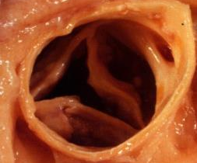
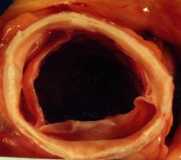
TAVR: From Idea to Validation of Concept
BAV
Rouen 1994: Autopsy study on 12 AS patients
Circular balloon expansion
is observed in all BAV cases
Post-23mm Balloon
Post-23mm Palmaz Stent
Question
Could a balloon expandable stent be used to stent open a calcified aortic valve ?
Circular stent expansion in ALL

Slide 14
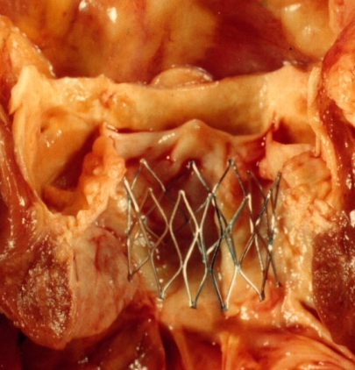
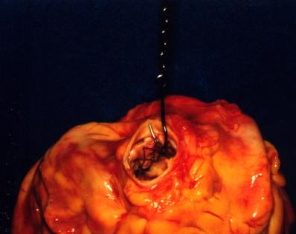
TAVR: From Idea to Validation of Concept
Coronary ostia
Rouen 1994: Autopsy study on AS patients
RCA
LM
Diameter 23mm
Anchoring test
Low risk of device
embolization
Heigth:
14/16 mm
IV Septum
Mitral Valve

Slide 15
Confirmative study just prior to F.I.M-TAVR.
R. Virmani, Martin Leon, Stan Rabinovich, Stan Rowe
Washington DCC, April 2002
Massive calcification
Circular stent opening

Slide 16
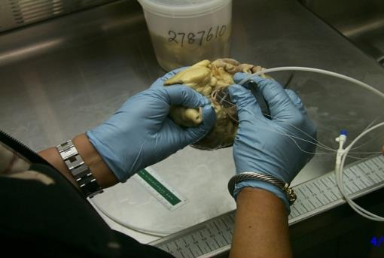
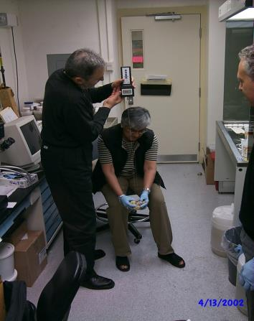
Confirmative study just prior to F.I.M-TAVR.
R. Virmani, Martin Leon, Stan Rabinovich, Stan Rowe
Washington DCC, April 2002
Low risk of device
embolization
Traction force >2kg
to dislodge the stent
Green light for the balloon- expandable valve

Slide 17
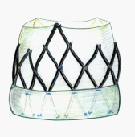
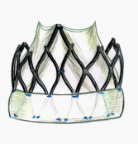
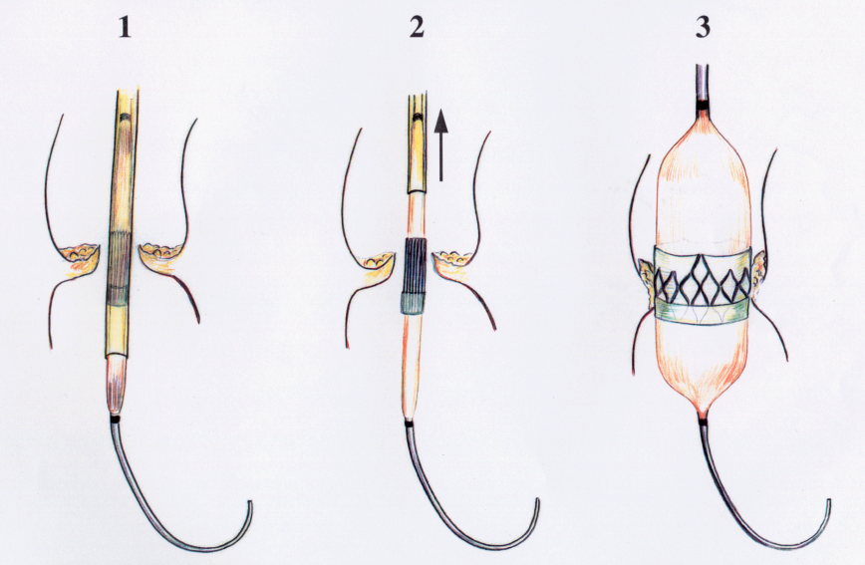
TAVR: Moving forward from Idea to Concept
Rouen 1994
Systole
Diastole
- Valve structure: biologic or polymer?
- High radial force balloon expandable stent
- External cuff
A. Cribier 1995
Hand-made Model of THV
Crimped diameter 8mm
External diameter compatible
with TF approach

Slide 18
Looking for a Sponsor
(All biomedical companies)
Experts (Surgeons)
“Totally unrealistic, major technical issues”
“Impossible to stent open a calcific aortic valve”
“Occlusion of coronary arteries in 100% of cases”
“Device embolization / stroke / endocarditis”
“Lack of durability”
“Would never be approved by FDA”
“Surgery covers 100% of the need. No indication”
“Most stupid project ever heard…”
Just forget it !...

Slide 19
1996: A first glimmer of hope
With the help of Stan Rabinovich (first met in 1994) and Stan Rowe (Business Development at JJIS), signed agreement with Johnson & Johnson / Cordis for a research program on Transcatheter Aortic Valve
Applied for Cribier-Letac European Patent, assigned to Cordis
Nothing done during 2 years
1998: Cordis terminated contract
Martin Leon enthusiastically
joined the group

Slide 20
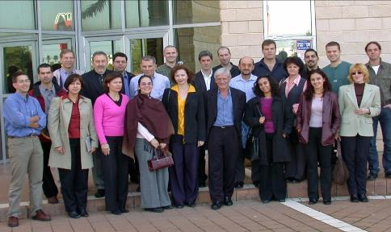
July 1999: Creation of Percutaneous Valve Technologies, Inc.
December 1999
Signed agreement with
ARAN R&D, Caesarea, Israel
Investment, Development
S. Rowe
S. Rabinovich
A. Cribier
M. Leon
The founders

Slide 21
July 1999: Creation of Percutaneous Valve Technologies, Inc.
Challenging requests to the engineers
A prosthesis made of a highly resistant frame
Containing a uni-, bi-, or tri-leaflet
valvular structure
Able to be homogeneously compressed over a high pressure balloon for its introduction into a sheath of 7 to 9 mm in diameter
Able to be enlarged by balloon inflation to an
external ø of 23mm without damaging
the frame and valvular structure
S. Rowe
S. Rabinovich
A. Cribier
M. Leon
The founders
And they made it !

Slide 22
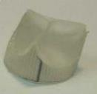
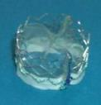
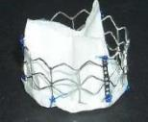
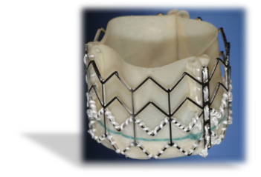
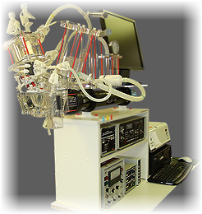
1999: PVT Valve Design Concepts
Finalized device: the PVT Valve
Tri-leaflet valve (polymer, then equine pericardium)
Stainless steel stent, 23mm in diameter
Hemodynamics
Durability (5 years)
Finite Element
Analysis
Radial Force
Fatigue

Slide 23
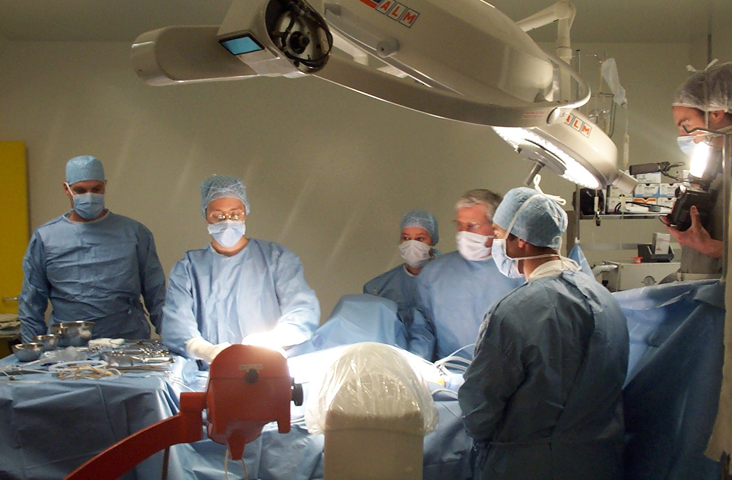
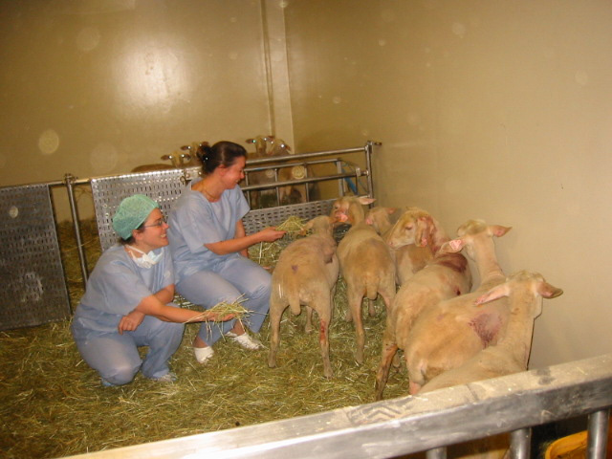
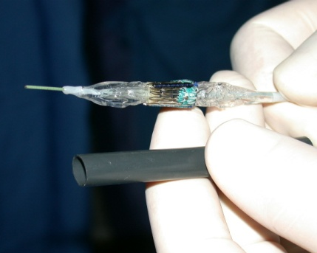
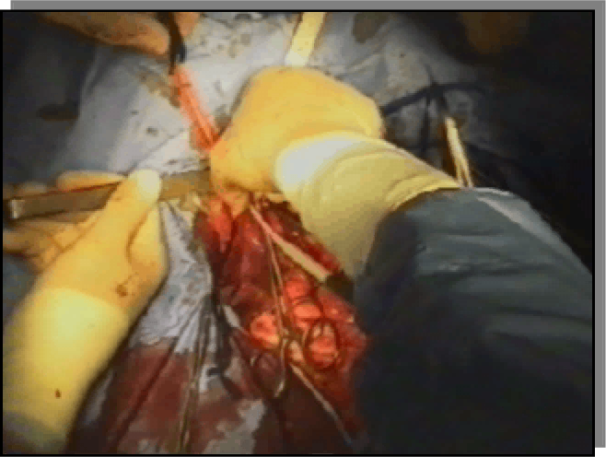
1999-2002: TAVR in Animal Model
Animal program (sheep model): acute and chronic (5 mos)
Crimped THV
Carotid approach
In-Ao valve implantation
TEE result at 5 months

Slide 24
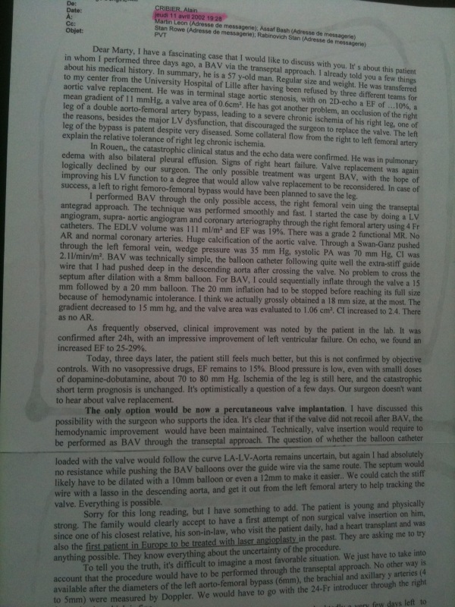
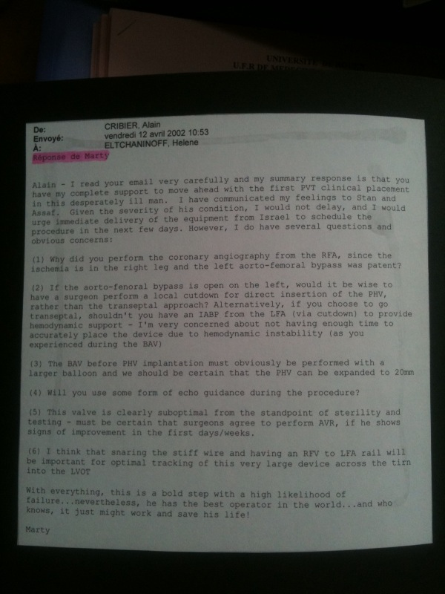
Alain Cribier to Martin Leon
Cc: Rabinovich, Rowe
April 12, 2002
The F.I.M. TAVR
Martin Leon to Alain Cribier
Cc Rabinovich, Rowe
April 12, 2002
Dear Marty, I have a fascinating case that I would like to discuss with you!
You have my complete support
to move ahead with the first PVT clinical placement in this
desesperately ill man.
Hear that?
this guy is
completely crazy
57 y/o
EF 10%
Cardiogenic shock
Cut down of the femoral artery?
Intra-LV thrombus
High likehood of failure but… it just might work
and save his life!
I am ready
What do you think?
IABP?
Imminent death
Snaring the stiff wire is a good
idea
Blocked femoral arteries
We can make it transeptal!
Externalization of guide wire
You are the best operator
in the world!
Highest risk !..

Slide 25
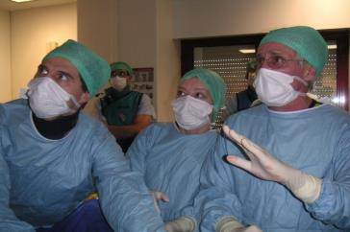
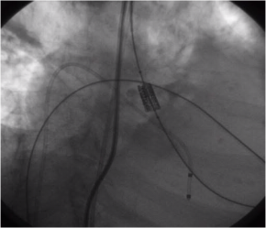
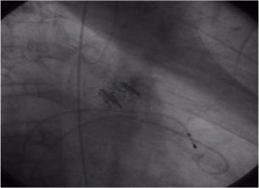
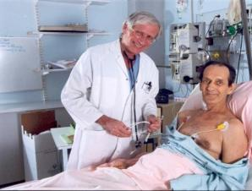
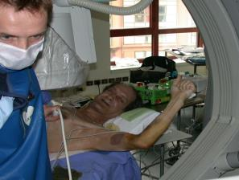
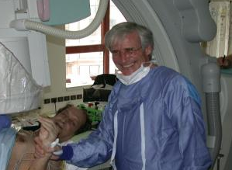
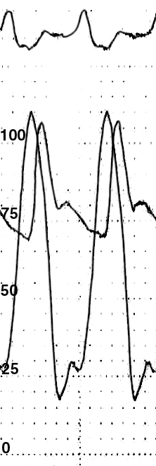
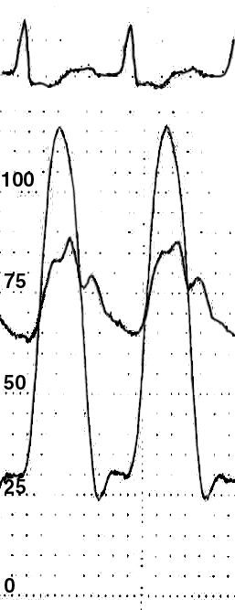
April 16th, 2002, Rouen, F.I.M –TAVI
From dream to reality
It works !
J-8
Day-8
Circulation. 2002 Dec 10;106(24):3006-8.
Notes:
25

Slide 26
April 2002: First ever seen transcatheter valve
in human on TEE

Slide 27
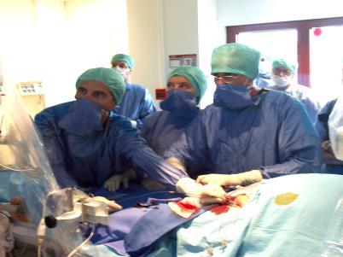
Lessons from this first case
1- Feasibility of TAVR
2- Accuracy of valve placement
3- No THV embolization
4- No coronary occlusion
5- No MR
6- Mild PVL
7- No AV-Block
8- Optimal valvular function
9- Excellent hemodynamics
First series
(Rouen, 2002-2004)
40 critical cases
I-REVIVE / RECAST trials
Transseptal approach (80%)
Retrograde approach 20%
PVL > grade 2: 25%
5 patients survived > 5 years
2004: First TAVR in USA

Slide 28
Sept 2003 # 10. First Planned Retrograde TAVR
- Female 85 y/o - Morbid obesity > 100kg - Severe CAD – Associated Mitral Stenosis
Sept 2003: massive pulmonary edema,
cardiogenic shock Declined for SAVR
Transferred from Paris in pre-mortem state Emergent TAVR : retrograde approach
Local anesthesia Procedure duration: 60 min
EOA: 0.60cm² to 1.62 cm²
5 Y post-TAVR
A first and good vision of
the future of TAVR !...

Slide 29
PVT – Board of Directors 2003
Stanton Rowe, President & CEO
Stan Rabinovich, Executive VP & COO
Jeff Barnes, Oxford Bioscience Partners
Yuval Binur, Medica Venture Partners
Abi Zakai, ARAN R&D, President
Marv Woodall, JJIS, Former President
Steve Oesterle, Medtronic, SVP, Medicine
Paul LaViolette, Boston Scientific, COO
A lot of gratitude to the first investors
Without their trust we won’t be there

Slide 30
2004- PVT Acquired by Edwards Lifesciences
New valves, new delivery systems, new approaches
From feasibility studies to larger clinical registries
and randomized trials
The start of a new era for TAVR

Slide 31
The issues of preclinical engineering
Bioprosthetic heart valve
Design-Geometry
Support structure: stent frame
Valvular structure: leaflets,
sealing skirt, attachment posts, anchoring/function, sutures
Material selection and characterization
Crimping / Loading system
Atraumatic, user-friendly
Delivery catheter system
Material manufacturing
and processing
Valve housing, shaft, working handle,
retrieve, profile, ergonomics

Slide 32
The issues of preclinical engineering
The” philosophy” of the transcatheter valve
Hemodynamic
High EOA / Low gradient
Proper coaptation of the leaflets
Tissue deflection matching
Minimized regurgitation / Leak
Safety
Minimized interference with anatomy
Low crimped profile
Deploy and anchor safely, predictably
Durability
Resistant Leaflet Tissue
Uniform stress distribution on leaflets
Leaflets resisting calcification

Slide 33
PVT – A wonderfull Scientific Advisory Board
Marty Leon, MD, Lenox Hill Hospital, New York
Alain Cribier, MD, Rouen University Hospital, Rouen
Jeff Moses, MD, Lenox Hill Hospital, New York
Donald Baim, MD, Harvard Medical School, Boston
Bill O’Neill, MD, Beaumont Hospital, Detroit
Mehmet Oz, MD, Columbia University Hospital
Antonio Colombo, MD, Columbus Hospital, Milan
Patrick Serruys, MD, Thoraxcenter, Rotterdam
Ted Feldman, MD, Evanston Hospital, Chicago

Slide 34
Two major indirect impacts of
this criticized procedure
1- Having pushed the cardiac surgeons, since the early 1990s, to expand the indications of SAVR to elderly patients (no age limit )
2- Having pushed our team to develop TAVR as a solution against early restenosis, using a similar procedural technique

