Slide 1
Translational Pathways for Catheter Ablation Development
Methods For Catheter
Ablation Development
Douglas L. Packer MD
ISCTR-TCT Consensus Summit
San Diego, California
September 21, 2018

Slide 2
Disclosures
Dr. D. Packer in the past 12 months has provided consulting services for Biosense Webster, Inc., Boston Scientific, CyberHeart, Medtronic, Inc., nContact, Sanofi-Aventis, St. Jude Medical, and Toray Industries. Dr. Packer received no personal compensation for these consulting activities.
Dr. Packer receives research funding from the NIH, Medtronic, Inc., Cryo Cath, Siemens AG, EP Limited, Minnesota Partnership for Biotechnology and Medical Genomics/ University of Minnesota, Biosense Webster, Inc. and Boston Scientific.
Mayo Clinic and Drs. D. Packer and R. Robb have a financial interest in mapping technology that may have been used at some of the 10 centers participating in this pilot research. In accordance with the Bayh-Dole Act, this technology has been licensed to St. Jude Medical, and Mayo Clinic and Drs. Packer and Robb received annual royalties >$10,000, the federal threshold for significant financial interest.
Notes:
CP947437 Packer, DL MC 8-3-2000
2

Slide 3
Integrated Research / Innovation Matrix
Unmet Needs
Dream/ Vision
Clinical Trials
Define
Discovery
Development
Methods For Catheter
Ablation Development

Slide 4
Translational Pathways for Catheter Ablation Development
Unmet
Clinical Needs

Slide 5
Un-Met Needs in Ablation
Discovery / Design / Think Tanks
Energy Sources / Energy Penetration
Catheter Delivery / 3D Navigation
Procedure Time / Single Interventions
Ablation Approaches/ Synergy AF/VT
Investigator / Regulatory / CMS /
Industry Collaboration: Early and Sustained
Innovation Cycle Times / Drive

Slide 6
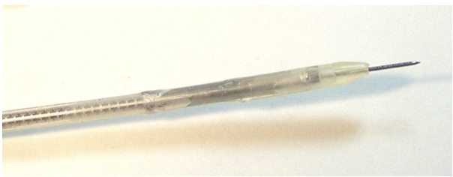
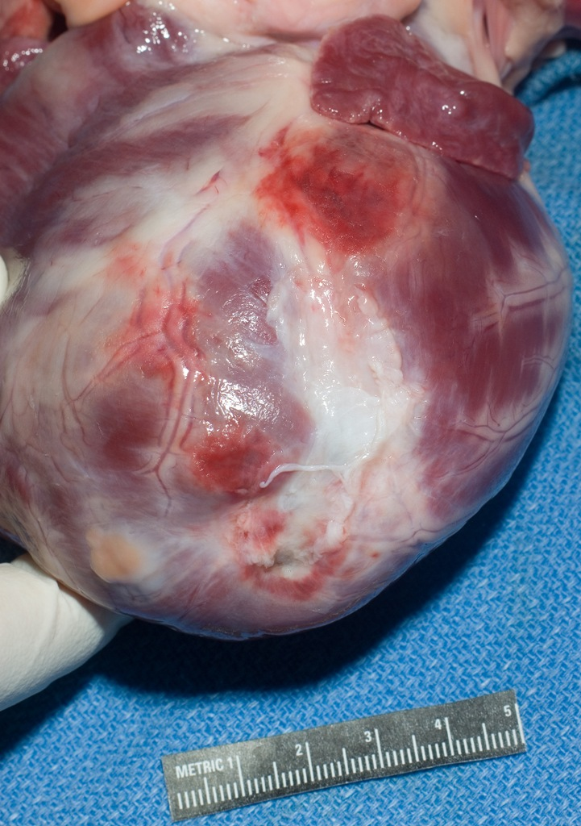
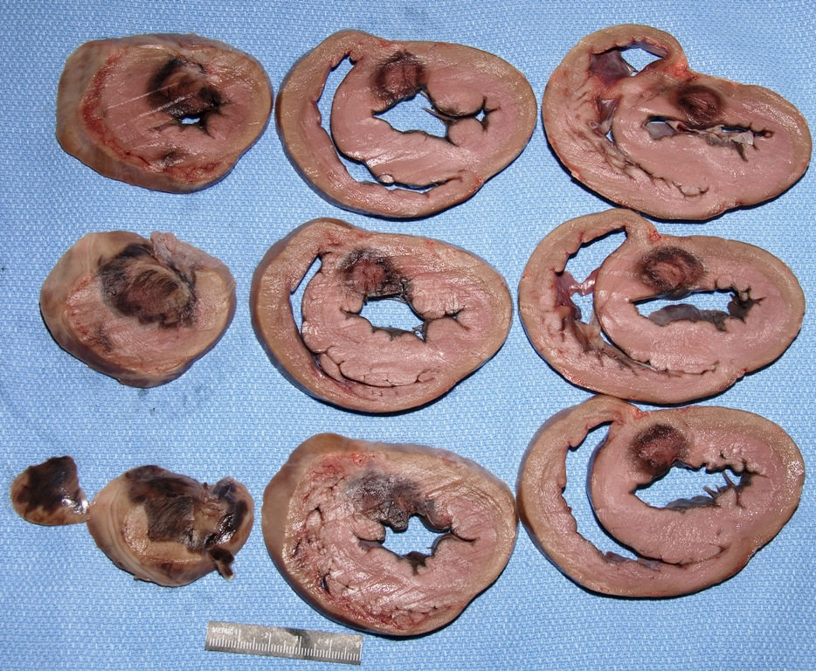
Design and Pathology of Needle Tip Ablation
Catheter
Tip Design
Saline warming electrodes
Infarct scar
lesion depth into scar tissue
18
15
12
12.6 ± 2.8 mm
Lesion Depth (mm)
9
6
3
Infarct scar
0
Linear lesion
Infarct scar
1% TTC stain and 10% formalin fixed

Slide 7
Integrated Image Guided Ablation
Pre-procedure
In procedure
Image
CT/MR imaging
2D fluoroscopy
Fusion
3D Rotational-CT
Navigation intervention
Image fusion
Mapping
ICE imaging
Electro- anatomic / NavX volumes
Carto sound
Image
2D ICE
Registration
3D ICE
Surface volume matching

Slide 8
Un-Met Needs in Ablation
Discovery / Design / Think Tanks
Energy Sources / Energy Penetration
Catheter Delivery / 3D Navigation
Procedure Time / Single Interventions
Ablation Approaches/ Synergy AF/VT
Investigator / Regulatory / CMS /
Industry Collaboration: Early and Sustained
Innovation Cycle Times / Drive

Slide 9
Translational Pathways for Catheter Ablation Development
Intellectual Property

Slide 10
Integrated Research / Innovation Matrix
Unmet Needs
IP Boundaries/ Limitations
Dream/ Vision
Contract / Legal Refinementt
Clinical Trials
Define
Discovery
Development
Greater Good vs Good for One

Slide 11
Translational Pathways for Catheter Ablation Development
Pre-Clinical Catheter Ablation Requirements and Testing

Slide 12
Integrated Research / Innovation Matrix
Unmet Needs
Boundaries/ Limititations
Dream/ Vision
Clinical Trials
Define
Refine
Discovery
Development
Hypotheses
goals, specific aims
Design
protocols
project

Slide 13
Integrated Research / Innovation Matrix
Unmet Needs
Boundaries/ Limititations
Dream/ Vision
Clinical Trials
Define
Refine
Discovery
Development
Hypotheses
goals, specific aims
Late Translational Computer Modeling Mouse/Rabbit
Langendorf Large animals
Early Translational Genomics OMICS
Proteins
Metabolism
Ion channel
Cell signaling
Design
protocols
project

Slide 14
Translational Pathways for Catheter Ablation Development
Pre-Clinical
End Points

Slide 15
Markers of Actual Energy Delivery
Temperature
Power /Current d
Electrogram ↓
Impedance
Microbubbles
Catheter tip icons [flashlights or red tips]
Contact force
Surrogates
Lesion Size
ICE image
Lesion footprint
Tissue temperature
AT / VT elimination
Real measures

Slide 16
Surfing the Surrogates
ref

Slide 17
Biophysical Matrix For Ablation
Power
Temp
EGM
Imped
Contact
Force
P
T
E
Imp
Ic
Icons
C F

Slide 18
Biophysical Matrix For Ablation
Power
Temp
EGM
Imped
Contact
Force
Icons

Slide 19
Translational Pathways for Catheter Ablation Development
Clinical
Evaluation

Slide 20
Evidence Trajectory in Clinical AF Ablation Trials
Mortality
Scientific
Merit,
Reliability,
Cost,
Value,
Quality
Safety
Efficacy
Early
single
center
Single
center
observ
Single
center
RCT
Meta-
Analysis
Multi-
center
registries
Multi-
center
RCT
Multiple
mortality
RCT
Pt (no.) 20 100 100 1000 10,000 1000 3,000
3000955-1

Slide 21
Integrated Research / Innovation Matrix
Results,
Technology, Procedures
MD/PT Adoption
Societal Guidelines
Unmet Needs
Boundaries/ Limititations
Dream/ Vision
Long Term Follow-Up
EFS
RCTs
Comparative Effectiveness
Registries
Big Data
Clinical Trials
Define
Refine
Discovery
Development
Hypotheses
goals, specific aims
Late Translational Computer Modeling Mouse/Rabbit
Langendorf Large animals
Early Translational Genomics OMICS
Proteins
Metabolism
Ion channel
Cell signaling
Design
protocols
project

Slide 22
End-Point Pyramid of AF Treatment
Approach to Patients After Ablation Therapy
The Clinician
The Issue
The theorist /purist
No AF
No drug
The warfarin worries
The pragmatist
No Sx AF
No intervention
Monitoring mandater
The happy nihilist
Occ AF w/Sx
No intervention required
The time bider
The reformist
75%↓ freq/duration of AF
Self-deception
The grateful
No AF on previously ineffective AAD
No change
↓↓DFT/↑↑ATP success
PPM prevention
<75%↓ in frequency/duration on drugs

Slide 23
AF Disease Severity Components
PRO:
Well established, objective
CON:
-Imprecise
-Arbitrary time cut-offs
-uncertain physiologic basis
PRO:
Quantitative
CON:
Only available on a small subset of patients have devices
Pattern / Progression
Paroxysmal
Burden
% time in AF (ILR or PPM in place)
Adverse
Events
Symptoms and Impact of AF
QOL scale hospitalization, cardioversion, drug therapy , PPM implantation, ablation
# of discrete AF episodes
Persistent
Longstanding persistent
Chronic
Complications of therapy (ablation, AAD)
Duration of diagnosis (time since first episode)
Post AblOR
Stroke, Sx, conversion pauses
PRO:
Describes the physiologic basis
CON:
Few standardized measures
AF Substrate
LA size
LA fibrosis
LV EF
Comorbidities (OSA, VHD, CHF etc.)
PRO:
Assess patient experience
CON:
Subjective or dependent on practice patterns
PRO:
Assesses impact of disease
CON:
Attribution of events to AF imprecise
Notes:
JPP: Peter, I think the key challenge is that while AF disease severity can be measured in an infinite number of ways, for the purpose of a clinical trial that will be absorbed by the clinical care community, whatever yardstick or measure we choose will need to be simple and reproducible and implicitly understood (intuitive).

Slide 24
PALPS (pattern, associations, lifestyle, percentage/burden, sequelae/complications
P
A
L
P
S
Pattern/progression
0=none
1=parox
Associations
Lifestyle impact
Percentage/burden
Sequelae/ complications
3=longstanding persistent
2= persistent
4=chronic
0=none
1=LAE
2=HTN, OSA
3=heart failure
4=severe MS, HCM
0=first quintile QOL score
1=second quintile QOL score
2=third quintile QOL score
3=fourth quintile QOL score
4=fifth quintile QOL score
0=none
1=longest episode <6min
2<50% more than 6 min
3>50% AF burden
4=100%
0=none
1=medicaiton escalation
2= hospitalization
3=major complication of therapy (bleed, TdP)
4=stroke
Notes:
I think this would be challenging for a variety of reasons. I do like the concept, but I think it is somewhat complex. Its probably easier to present the data in each category in a more translucent way. For example, KM of AF progression to Prs forms of AF, KM of incident HF, CCS class over time, plot of SR at each follow-up in each arm, KM plot of incident AF hospitalization.

Slide 25
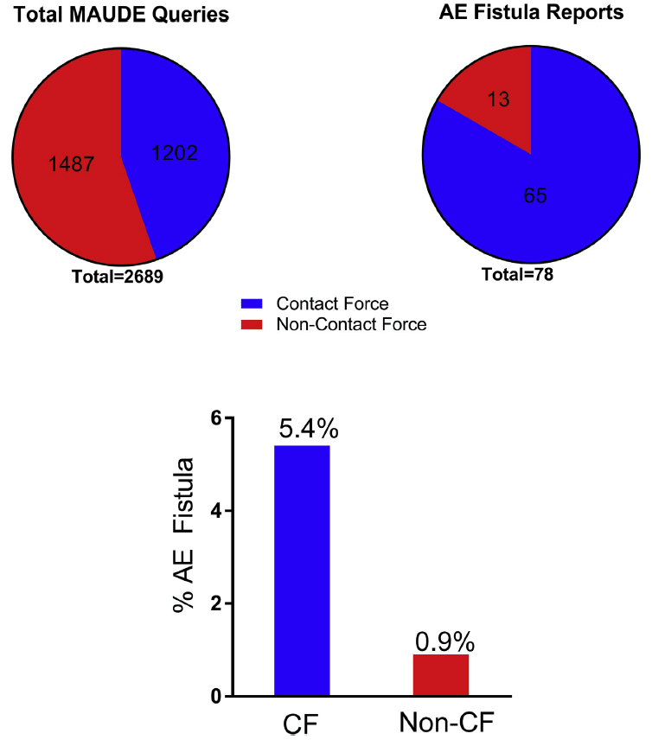
Atrio-esophageal Fistula Cases: Contact Force vs. Non-contact Force
Paccini J, et al. Heart Rhythm 2017:1328

Slide 26
Translational Pathways for Catheter Ablation Development
Reimbursement

Slide 27
Reimbursement / Costs
Design
Costs
Reimbursement
CMS, Third Party Payments
Development
Expense
Funding
Clinical Trials
Regulatory
Translational Research
Bench →Bedside
EFS to IDE
Manufacturing

Slide 28
Road to Integrated Research / Innovation Matrix
Results,
Technology, Procedures
MD/PT Adoption
Societal Guidelines
Unmet Needs
Boundaries/ Limititations
Dream/ Vision
Long Term Follow-Up
EFS
RCTs
Comparative Effectiveness
Registries
Big Data
Clinical Trials
Define
Refine
INNOVATION
Integrated Matrix
Discovery
Development
Hypotheses
goals, specific aims
Late Translational Computer Modeling Mouse/Rabbit
Langendorf Large animals
Early Translational Genomics OMICS
Proteins
Metabolism
Ion channel
Cell signaling
Design
protocols
project

Slide 29
Translational Pathways for Catheter Ablation Development
Future of
Catheter Ablation

Slide 30
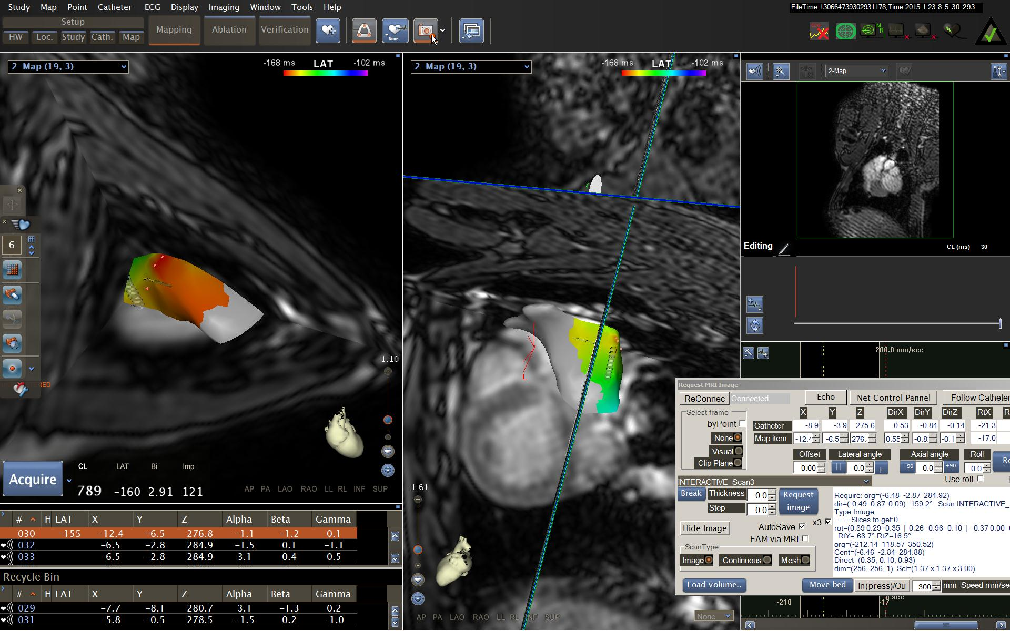
Real Time MR Guidance of Ablation

Slide 31
MR Overlay of Endocardial Maps

Slide 32
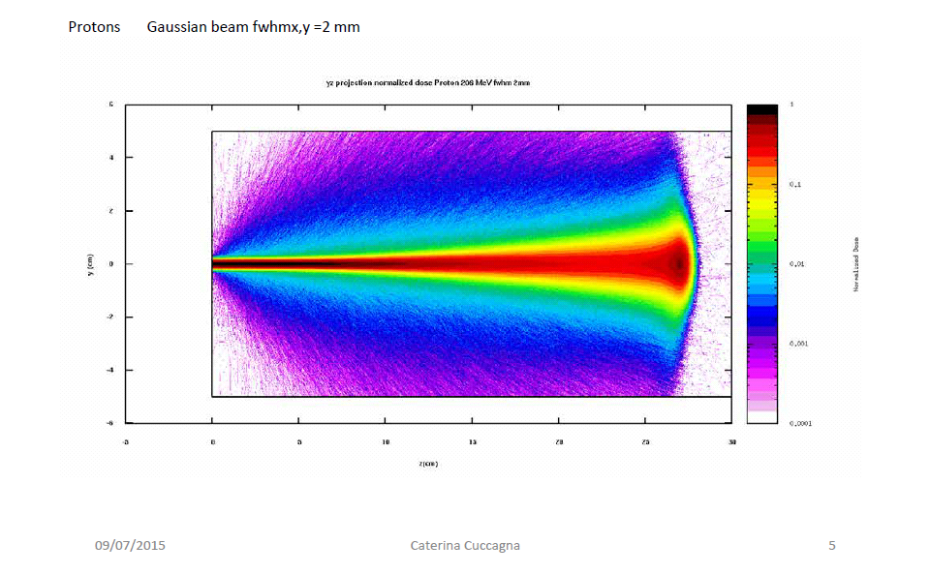
Characteristics of Photon/Particle Therapy
Bragg Curves for Carbon Ions, Protons
Effects of particle therapy
↑↑ biological effectiveness
↑ ionization density
↑↑ DNA damages
↑ dose localization
Bragg peak
Relative dose
Photons 21 MeV
¹²C 270 MeV/u
Protons 148 MeV/u
Depth in water (mm)
Fokas, Kraft, An, Cabillio: Science Direct 216:1, 2009
Ugo Amaldi CERN Plasma Collider Center 2015
Notes:
32
CP947437 Packer, DL MC 8-3-2000

Slide 34
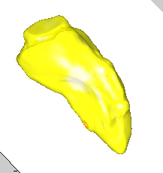
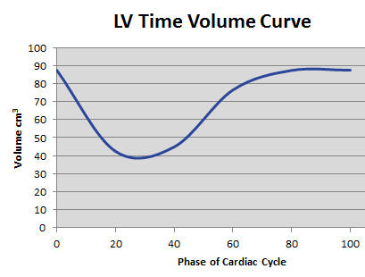
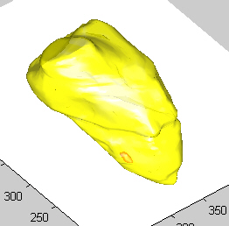
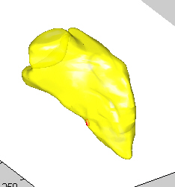
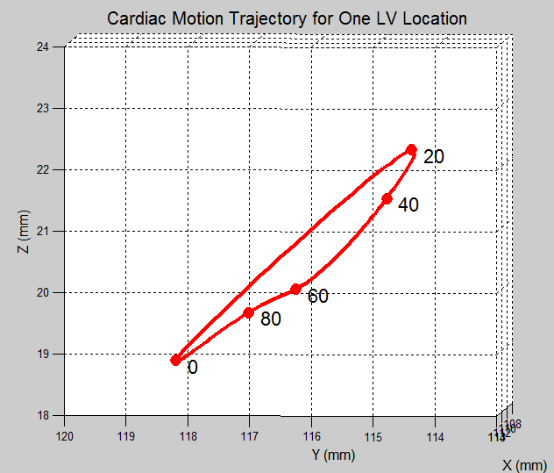
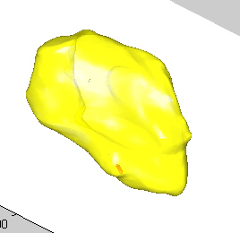
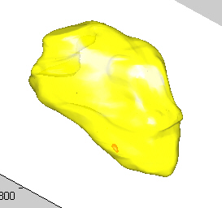
3D Motion Trajectory in LV from One Segmented Clip
phase 20
phase 0
phase 40
3D rendering of left ventricle (yellow) and segmented clip (red).
Arrows show trajectory for one LV location at 0,20,40,60,80% of cardiac cycle
phase 80
phase 60

Slide 35
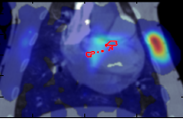
2 Field Scanned Proton Isodose Lines
Notes:
CP947437 Packer, DL MC 8-3-2000

Slide 36
Integrated Research / Innovation Matrix
Results,
Technology, Procedures
MD/PT Adoption
Societal Guidelines
Unmet Needs
Boundaries/ Limititations
Dream/ Vision
Long Term Follow-Up
EFS
RCTs
Comparative Effectiveness
Registries
Big Data
Clinical Trials
Define
Refine
INNOVATION
Integrated Matrix
Discovery
Development
Hypotheses
goals, specific aims
Late Translational Computer Modeling Mouse/Rabbit
Langendorf Large animals
Early Translational Genomics OMICS
Proteins
Metabolism
Ion channel
Cell signaling
Design
protocols
project

